Slide 1
NSF Funding Opportunities
AUCD 2024
DR. RONDA JENSON
Dr. Keri Ann Sather-Wagstaff

Slide 2
NSF Funding Opportunities for Disability-Focused Projects and Research
NSF 23-593 Workplace Equity for Persons with Disabilities in STEM and STEM Education
NSF 21-110 Dear Colleague Letter: STEM Access for Persons with Disabilities (STEM-APWD)
NSF 21-576: Alliances for Graduate Education and the Professoriate (AGEP)
NSF 20-554: ADVANCE: Organizational Change for Gender Equity in STEM Academic Professions (ADVANCE)
NSF 22-622: NSF's Eddie Bernice Johnson Inclusion across the Nation of Communities of Learners of Underrepresented Discoverers in Engineering and Science (INCLUDES) Initiative

Slide 3
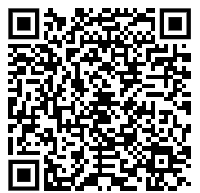
NSF 23-593 Workplace Equity for Persons with Disabilities in STEM and STEM Education
Due Sept. 16, 2025
Project Types: Research, synthesis, conference, Early-concept Grants for Exploratory Research (EAGER), and Rapid Response Research (RAPID)

Slide 4
NSF 23-593 Workplace Equity: 3 Themes
Studying barriers and solutions to diversity, equity, inclusion, and accessibility in STEM and STEM education workplaces and training settings for persons with disabilities;
Applying intersectional social identity perspectives to investigate characteristics and conditions of STEM and STEM education workplaces and training environments that limit and/or improve diversity, equity, inclusion, and accessibility for persons with disabilities
Conducting use-inspired and solution-oriented translational research about diverse, equitable, inclusive, and accessible STEM and STEM Education workplaces and training settings for persons with disabilities

Slide 5
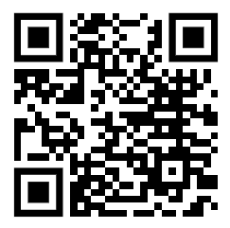
NSF 21-110 Dear Colleague Letter: STEM Access for Persons with Disabilities (STEM-APWD)
Encourages submission of new proposals, or requests for supplemental funding to existing awards, to support existing or new access to and engagement in STEM learning, research, and workforce development at proposing or awardee organizations for NSF-funded students, postdoctoral scholars, or faculty and staff with disabilities. ​
​23 NSF programs participating
Notes:
Proposers are encouraged to explore a wide range of actions to support access to and engagement in STEM learning, research, and employment activities of persons with disabilities, such as, but not limited to:
Stipends for K-12 students and teachers, undergraduate students and/or graduate students with disabilities to provide greater access to and engagement in EHR-funded STEM education and research project activities, and/or STEM education and research training.
Funding to increase time and effort for undergraduate students, graduate students, postdoctoral research scholars, staff, faculty and/or senior personnel with disabilities to work on EHR-funded STEM education and research project activities.
Support for technology, tools, equipment and instrumentation, and the physical modifications necessary to access them (e.g., elevated or lowered lab table), in research labs, libraries, informal science settings, field-based environments and/or classrooms that ensure students, postdoctoral research scholars, K-12 teachers, staff and faculty with disabilities will have greater access to and engagement in STEM research, teaching, training and learning.
Organizations submitting new proposals are encouraged to highlight the request for funds to support STEM access and engagement for persons with disabilities in the Project Summary, the Project Description and the Budget Justification. When responding to this DCL, please include "Disability Access DCL:" at the beginning of the proposal title or immediately following any solicitation specific title prefix. The receiving program will determine whether and at what level to fund new proposals or supplement requests.

Slide 6
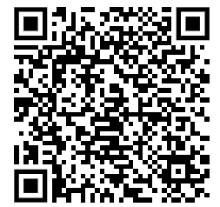
NSF 21-576: Alliances for Graduate Education and the Professoriate (AGEP)
Supports projects to study and address systemic barriers to success for STEM doctoral candidates, postdocs, and junior faculty members in alliances of institutions of higher education, with an intersectional racial equity lens.
Axes of marginalization include race/ethnicity, gender, and disability.
Barriers may include policies, practices, procedures, culture, and climate around
Equitable accommodations and medical leave
Equitable recruitment, hiring, and admissions
Equitable workload, startup, lab space

Slide 7
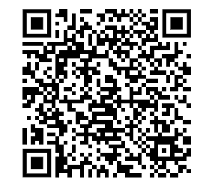
NSF 21-576: Alliances for Graduate Education and the Professoriate (AGEP)
Supports projects to study and address systemic barriers to success for STEM doctoral candidates, postdocs, and junior faculty members in alliances of institutions of higher education, with an intersectional racial equity lens.
Tracks:
AGEP Catalyst Alliance (ACA): up to $400K for capacity-building: organizational self assessment and equity strategic planning. (Deadlines: March and August)
Institutional Transformation Alliance (ITA): up to $4.4M to implement sustainable, systemic change projects from ACA strategic plan. (Deadline: August. Requires ACA and pre-proposal due in February.)

Slide 8
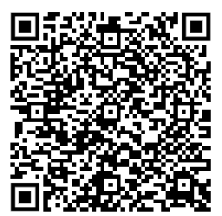
NSF 20-554: ADVANCE: Organizational Change for Gender Equity in STEM Academic Professions (ADVANCE)
Supports projects to study and address systemic barriers to success for STEM faculty members in institutions of higher education and organizations, with an intersectional gender equity lens.
Tracks:
Catalyst: up to $300K for capacity-building: organizational self assessment and equity strategic planning. (No Deadline)
Adaptation: up to $1M/$1.25M to adapt research-informed sustainable, systemic change projects from Catalyst strategic plan. (Deadline: November. Requires Letter of Intent in August.)
Institutional Transformation (IT): up to $3M to implement innovative, sustainable, systemic change projects plus social science research. (Requires pre-proposal. No deadlines.)
Partnership: up to $1M/$1.25M to adapt research-informed sustainable, systemic change projects with partners. (Deadline: November. Requires Letter of Intent in August.)

Slide 9
NSF 20-554: ADVANCE: Organizational Change for Gender Equity in STEM Academic Professions (ADVANCE)
Case study: ADVANCE Partnership: AccessADVANCE
University of Washington, EES – 2017017, North Dakota State University, EES - 2017054
AcccessADVANCE will
engage a nationwide online community of practice and
provide on-site capacity-building institutes.
The purpose of this engagement is to develop systemic change strategies for postsecondary STEM departments and other organizations that make them more welcoming to and inclusive of female faculty with disabilities.
Importantly, the project will
provide ongoing technical assistance to collaborators to help make changes to policies, practices, and resources; and
develop widely available online resources related to institutional practices to increase the success and advancement of women with disabilities in academic STEM careers.

Slide 10
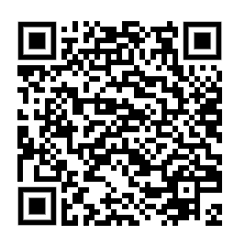
NSF 22-622: NSF's Eddie Bernice Johnson Inclusion across the Nation of Communities of Learners of Underrepresented Discoverers in Engineering and Science (INCLUDES) Initiative
Alliances: Due October 28, 2025
Network Connectors: Due October 28, 2025
Conferences: Submitted anytime but before May 13, 2025 for consideration in current fiscal year
Other: Collaborative Change Consortia and Design and Development Launch Pilots: Next due date in 2026

Slide 11
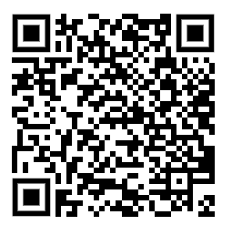
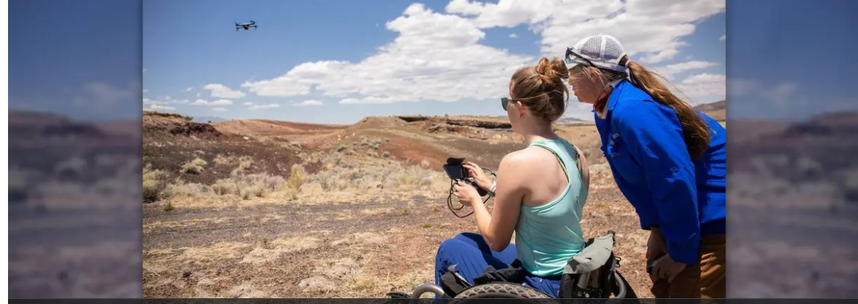
NSF supports efforts to emphasize the ability in 'disability’ (10/23/2024)

Slide 12
Contact us!
Dr. Ronda Jenson, rjenson@nsf.gov
Dr. Keri Ann Sather-Wagstaff ksatherw@nsf.gov

