Slide 1
The Social Determinants
of Health

Slide 2
Social Determinants
The social determinants of health are those factors which are outside of the individual; they are beyond genetic endowment and beyond individual behaviors. They are the context in which individual behaviors arise and in which individual behaviors convey risk. The social determinants of health include
individual resources, neighborhood (place-based) or community (group-based) resources, hazards and toxic exposures, and opportunity structures.
        – Camara Jones, CDC, 2010

Slide 3
Social Determinants of Health
Two thousand years (up to 1850s):
Illness as humors out of balance
Physician investigated a patient’s environment & habits
No clear distinction between public and personal health
By 1930s:
Illness as disruption of the body by an invading organism
Physician treats individual patients; public health professionals deal with epidemics & environment
– Jeff Brosco

Slide 4
History of Medical Care in the US
1850s
General practice
Varied training
Rural/local/isolated
Low income/prestige
+/-State license
Pre-germ theory
Eclectic therapies
1930s
Specialization
Standardized training
Urban/connected
Reasonable income/prestige
License required
Scientist as hero
– Jeff Brosco

Slide 5
Hospital Operating Suite, c.1910

Slide 6
Health Equity
Where systematic differences in health are judged to be avoidable by reasonable action they are, quite simply, unfair. It is this that we label health inequity.
Putting right these inequities – the huge and remediable differences in health between and within countries – is a matter of social justice.
– World Health Organization Commission
on Social Determinants of Health

Slide 7
Health Disparities (Birth Outcomes)
1970s –2000: solution to disparities is improve health care
Better/more accessible prenatal care
Better/more accessible neonatal care
Governmental and private actions improved prenatal care rates and decreased disparities in health care, but poor outcomes worsened and disparities increased
“You can’t cure a lifetime of ills in nine months of a pregnancy”
– Milton Kotelchuck

Slide 8
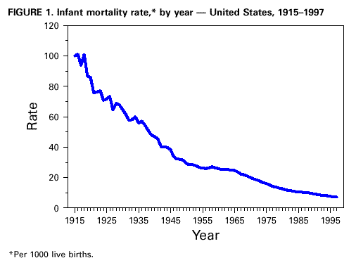
Infant Mortality
(U.S. Bureau of Statistics)

Slide 9
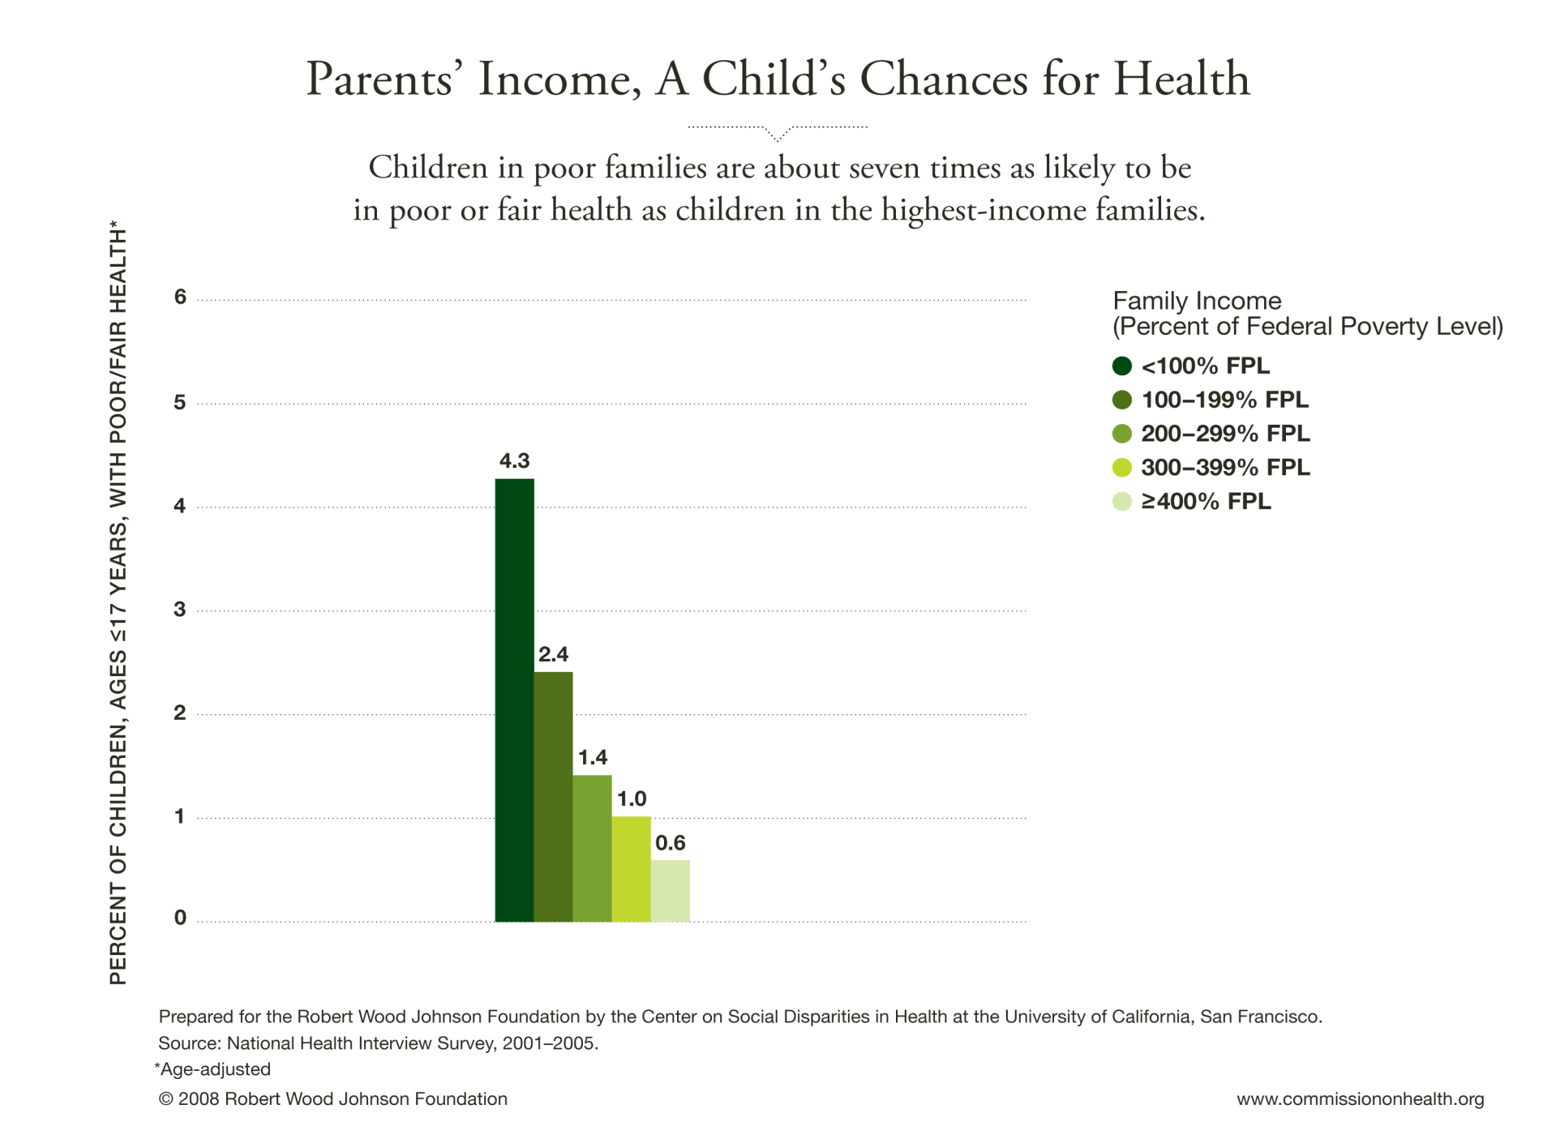

Slide 10
The New 21st Century Scientific Basis for the MCH Life Course
Provides an understanding of how the social environment gets built into or embodied into our physical bodies
Bridges our intuitive understanding of the social causes of ill health (poverty, malnutrition, stress) with our understanding of its clinical manifestations and treatment
Incorporates our growing scientific understanding of the biology of human development into our health trajectories
Focuses on root causes of illness and disparities
– Cheri Pies

