Slide 1
Life Course Model
as an
Organizational Framework

Slide 2
Key Definitions and Concepts
Life Course (vs. Life Cycle and Life Span)
Risk and Protective Factors
Pathways and Trajectories
Early Programming
Cumulative Impact
Critical or Sensitive Periods

Slide 3
Clarifying Terms
Life Span: length of time a species is capable of living or the length of an individual’s life
Life Cycle: regular, predictable series of life stages or reproductive cycle
Life Course: age-graded developmental trajectories shaped by contexts
– Johns Hopkins School of Public Health

Slide 4
What is Life Course?
Life Course is a theory or perspective that seeks to understand, explain, and improve health and disease patterns across population groups.
– Amy Fine
Life Course suggests that a complex interplay of biological, behavioral, psychological, and social protective and risk factors contribute to health outcomes across the span of a person’s life.
– Cheri Pies

Slide 5
Life Course Concepts ‘T2E2’
Timeline – health is cumulative and longitudinal, i.e., developed over
a lifetime.
Timing – health and health trajectories are particularly affected during critical/sensitive periods.
Environment – the broader environment (biologic, social, physical, economic) affects health and development.
Equity – health inequality reflects more than genetics and personal choice.
– Fine and Kotelchuck

Slide 6
A life course approach recognizes the role of time in shaping health outcomes and incorporates time into models explaining health outcomes.

Slide 7
How Time Matters
Individuals’ health changes over time.
Determinants of health vary over time.
Relations between determinants and health can change over time.
Relation between determinants and health may depend on time.
– M.E. Hughes, JHSPH

Slide 8
Time Scales
Individual time (chronological age, physical maturation, social norms)
Historical time (calendar year, year born, technological development,
social change)
Others may be important for specific outcomes

Slide 9
Possible Time Patterns
Trajectories
  Upward, downward or mixed
Relation between determinants and health
  Latent
  Accumulation
  Pathways
  Critical and sensitive periods
  Triggers
– M.E. Hughes, JHSPH

Slide 10
Risk and Protective Factors
Protective factors improve health and contribute to healthy development. Risk factors diminish health and make it more difficult to reach one’s full potential.
Factors are not limited to individual behavior or access to health, but can include family, neighborhood, community, and social policy.

Slide 11
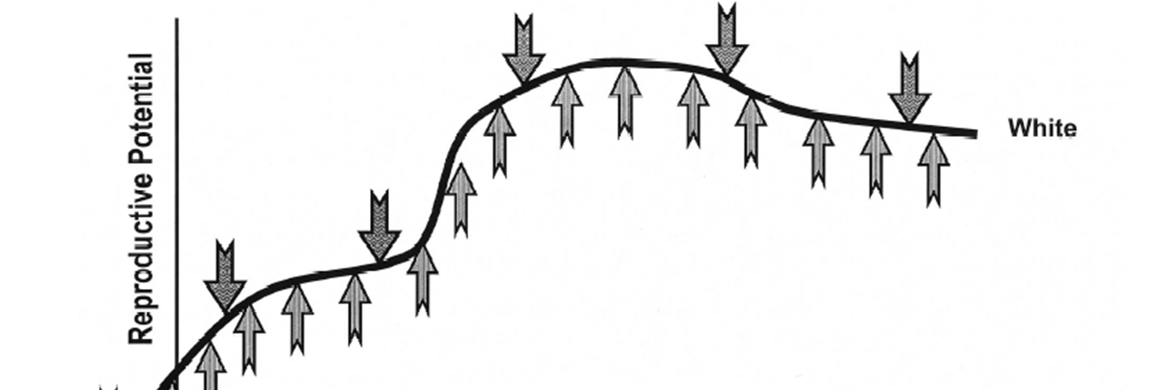
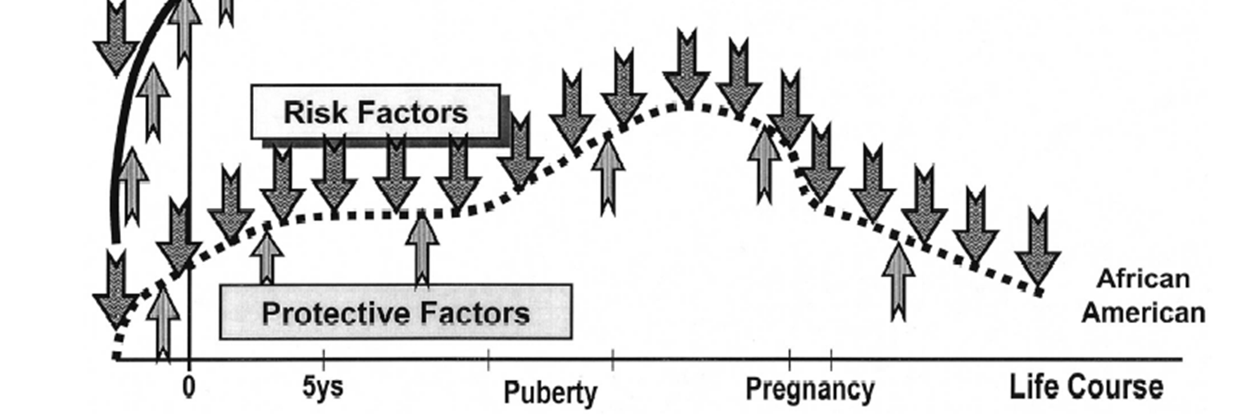
Life Course Perspective
– Michael Lu and Neal Halfon
Racial and ethnic disparities in birth outcomes: a life-course perspective.
Maternal Child Health J. 2003; 7:13-30.

Slide 12
Pathways and Trajectories
Health pathways, or trajectories, are built or diminished over the life span. While individual trajectories vary, patterns can be predicted for populations and communities based on social, economic, and environmental exposures and experiences.
– Fine and Kotelchuck, Rethinking MCH: The Life Course Model
as an Organizing Framework, Concept Paper, DHHS, HRSA, October 2010.

Slide 13
Early Programming
Early experiences can program an individual’s future health and development. This includes prenatal programming as well as intergenerational programming (i.e. the health of the mother prior to conception) that impact disease or condition, or make and individual more vulnerable or susceptible to developing a disease or condition in the future.
– Fine and Kotelchuck, Rethinking MCH: The Life Course Model
as an Organizing Framework, Concept Paper, DHHS, HRSA, October 2010.

Slide 15
Cumulative Impact
While individual episodes of stress may have minimal impact in an otherwise positive trajectory, the cumulative impact of multiple stresses over time may have a profound direct impact on health and development, as well as an indirect impact via associated behavioral or health services seeking changes.
– Fine and Kotelchuck, Rethinking MCH: The Life Course Model
as an Organizing Framework, Concept Paper, DHHS, HRSA, October 2010.

Slide 17
Critical or Sensitive Period
While adverse events and exposures can have an impact at any point in a person’s life course, the impact is greatest at specific critical or sensitive periods of development (e.g. during fetal development, in early childhood, during adolescence, etc.).
– Fine and Kotelchuck, Rethinking MCH: The Life Course Model
as an Organizing Framework, Concept Paper, DHHS, HRSA, October 2010.

Slide 18
Is Life Course Old or New?
LCT marries long-term MCH concepts with new science
Barker Hypothesis – links LBW to increased risk of heart disease, diabetes.
Felitti’s ACE Study – links early childhood adverse events to increased risk of obesity, heart disease, diabetes, depression.
Neurons to Neighborhoods, NAS – early environments, nurturing relationships, parents are the “active ingredients” in healthy brain development – from the earliest ages forward.

Slide 19
Is Life Course Old or New? (cont.)
Lu/Halfon – link disparities in birth outcomes to differential developmental trajectories of the mother, based on early life experiences (programming) and cumulative stress.
Epi-genetics – links environmental triggers to gene expression.
The same science is also informing other fields.
– Milton Kotelchuck

Slide 21
MCH Life Course Literature Focuses on
Two Key Questions
Why do health disparities exist and persist across population groups?
What are the factors that influence the capacity of individuals or populations to reach their full potential for health and well-being?

Slide 22
Additional Concepts to
Life Course Perspective
Interactive processes – The development of health over a lifetime is an interactive process, combining genes, environments and behaviors.
Lifelong development/lifelong intervention – Throughout life and at all stages, even for those whose trajectories seem limited, risk factors can be reduced and protective factors enhanced, to improve current and subsequent health and well-being.
– Fine and Kotelchuck

Slide 23
Critiques and Questions
Early programming — too deterministic?
Too front-loaded? What does LCT tell us about later life stages?
What does LCT tell us about CSHCN?
How does LCT interface with genetic services?
If it is all connected over a lifetime, how do we make the case for a focus on Maternal and Child Health?
– Amy Fine

Slide 24
Aligning Practice with LCT
But, LCT also…
Greatly expands the opportunities for intervention: a much broader set of venues and partners over a much longer timeline
Suggests the need for better linkage (vertical, horizontal, temporal)
Encourages us to rethink and realign some of the current strategies and add new ones
– Amy Fine

Slide 25
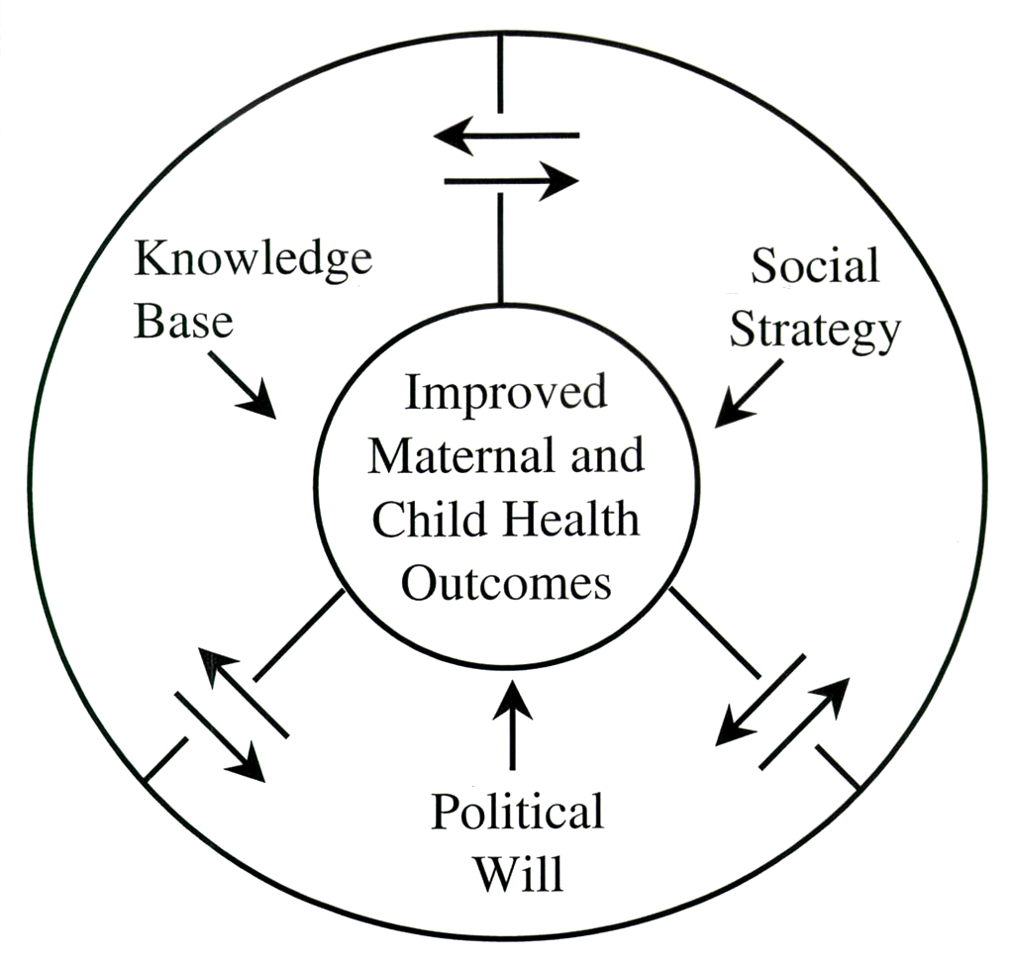
A System’s Approach
– Richmond and Kotelcheck

