Slide 1
AUCD National Conference Hill Visits
From Scheduling to Successful Meetings
A 60-minute training from the AUCD Policy Team

Slide 2
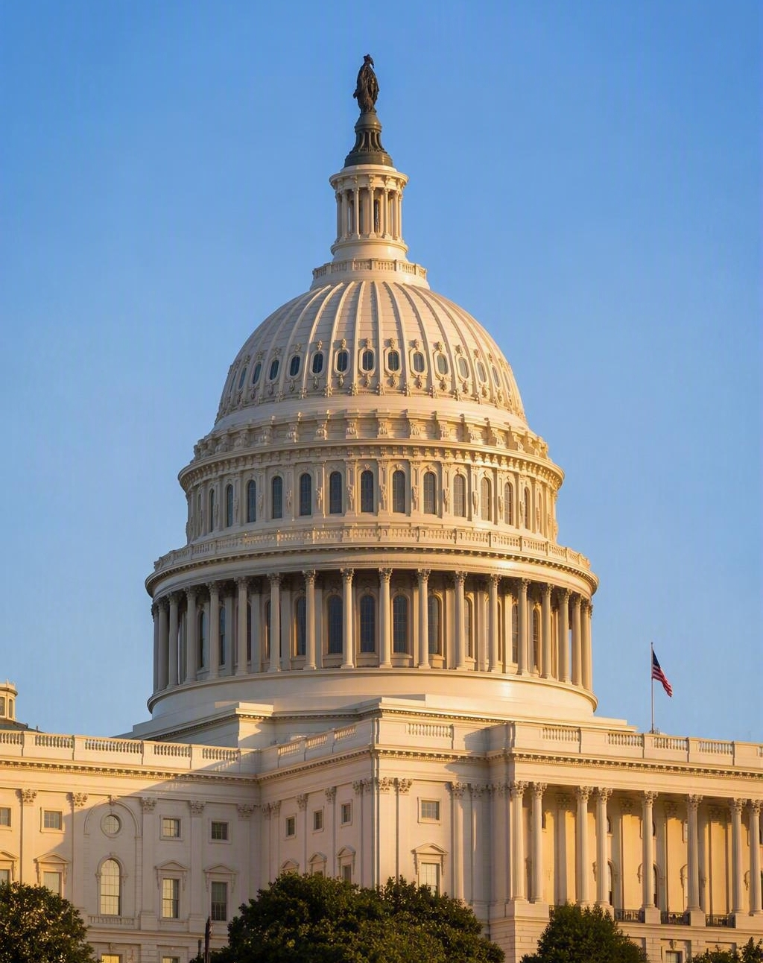
Your Conference + Your Hill Visit
You’ll already be in Washington for the Annual Conference
Congressional offices are close by and open to constituents
Staff can see the breadth of the AUCD Network firsthand
Members of Congress need to hear from people doing this work in their states
Hill visits complement AUCD’s federal advocacy
Your timing is perfect!
  Congress is finalizing appropriations when you are having your meetings

Slide 3
Advocate, Educate, Lobbying – What’s the Difference?
You are allowed to advocate and educate, even as federally funded programs:
“grantees have been authorized to undertake such action [‘educate,’ ‘advise’ or ‘inform’ Federal, State and local policymakers] in order to assist policymakers [members of Congress, officials of the Federal executive branch, Governors, members of State legislatures and staff of State agencies] to improve the services and opportunities available to individuals with developmental disabilities and their families.”
https://acl.gov/sites/default/files/about-acl/2020-06/ADD%20PI-01-1%20Lobbying.pdf
Sharing best practices, stories, data, and information about your work is educating policy makers to improve services and opportunities. Requesting increased appropriations is advocating to improve services and supports.

Slide 4
Advocate, Educate, Lobbying – What’s the Difference?
You are typically NOT permitted to lobby:
Put simply, when individuals or groups, on behalf of a client who has paid them (or employed them), communicate directly with federal officials to persuade them to support a specific cause, change a law, or approve a policy.
Lobbying Disclosure Act: https://www.senate.gov/legislative/Lobbying/Lobby_Disclosure_Act/3_Definitions.htm

Slide 5
What Makes a Good Hill Visit?
Meetings are typically between 15-20 minutes.
Most meetings are led by staff; it is unlikely the members of congress will attend (that’s OK!)
You develop the start to a relationship – you can call and email them, they can reach out to you.
Staff understand what your program does.
Staff see why it matters in their state or district.
You made a clear request.
You opened the door to future conversations.
You did not do all the talking! Ask questions, create a conversation.

Slide 6
Representatives & Staffers are Regular People
You will likely be meeting with staff – they are real people!
Don’t assume – get to know who you are meeting with at the beginning. Ask if they are familiar with issues impacting people with intellectual and developmental disabilities. Find out what they know and issues they cover.
Create a conversation. No one wants to be talked at for 20 minutes. Engage the staff in a conversation about the work as you tell a story.

Slide 7
Part 1 — Who Are You Meeting With?
Members, staff, and why constituency matters
Notes:
Short breath before Part 1.
Thanks Kim, now we are going to talk who are you meeting with . constituency matters because you live in their state or district, and can vote for them. They will listen to you more than they will listen us.

Slide 8
Know Your Members of Congress
Every constituent has two U.S. Senators and one U.S. Representative.
Senate
Represents the entire state
Two Senators per state
Offices in Russell, Dirksen, and Hart
House
Represents one congressional district
One Representative per district
Offices in Cannon, Longworth, and Rayburn
Notes:
We all have 2 senators, because both of the Senators represent the entire state , and we have 1 representative who resents your district, To find your rep., you'll need to fill in your zip code.

Slide 9
You’re Probably Meeting Staff — and That’s Good
Legislative Director (LD) — runs the office’s overall policy agenda
Legislative Assistant (LA) — covers a portfolio of issues, often health or disability policy
Legislative Correspondent (LC) — tracks constituent mail and helps on issues
Committee staff — deep expertise on specific legislation
You don’t need to meet the Member for the meeting to matter.
Notes:
Most of the time you will meet with staff.. there’s two reasons for that.
Staff have more time to give to you
Staff does all the research on a topic

Slide 10
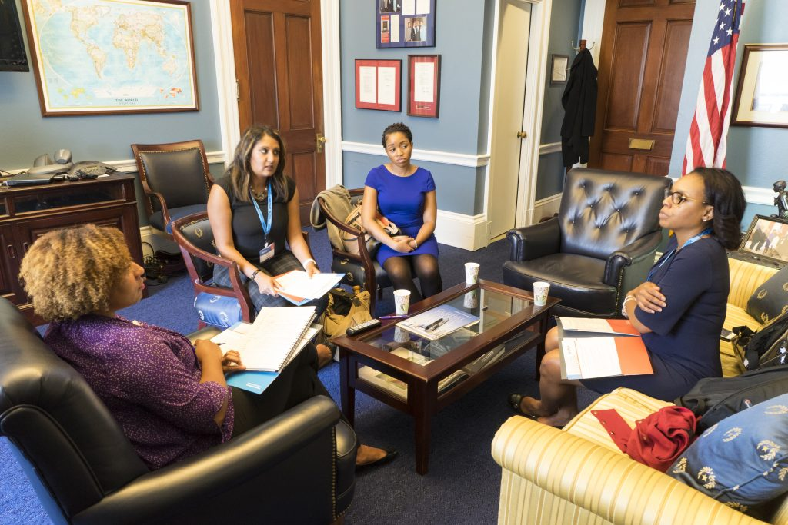
Who Should You Visit?
Try to set at least two meetings.
  You may want to meet as a state delegation or as your center. Decide in advance.
Request meetings with both Senators that represent your state (for your center).
Request meetings with 1-3 House members who represent the communities your center serves.
Find contact information on the websites for each member.
Notes:
Walk the questions like a decision tree. The real point is the last line - constituency. If there's time, ask a couple of people to say out loud which office they're visiting and why. Good energy check.

Slide 11
House vs. Senate: Why It Matters
House
District-based representation
One Representative per district
Staff are often focused closely on constituent concerns
Senate
Statewide representation
Two Senators per state
A larger, more varied constituency
Often more issue-specific staff
The strategy is the same either way: Who are you? What do you do? Why does it matter here? What do you need from Congress?
Notes:
The house and the senate is different because they focus on different things

Slide 12
Part 2 — Setting Up Your Hill Visits
Timelines, meeting requests, and coordinating with AUCD

Slide 13
Start Early: Your Scheduling Timeline
Before the conference
Conference week and after
Now — Identify House/Senate member offices that you want to meet with. Submit your meeting requests as soon as possible! The longer you wait, the less likely you will get a meeting.
1–2 weeks out — If the office hasn't responded after 1 week, follow up and politely ask again. (Note: Congress is in recess so there might be some delays.)
Week of — Be on the lookout for time/room changes, even on the day of the meetings. Plan your routes to each meeting.
Within 24–72 hours — Send thank-you notes to the staffers and any requested materials, and update AUCD.
  Please have one member of your team send an email to Liz and Kim with a brief summary of the meetings.

Slide 14
How Do I Ask for a Meeting?
Requesting a meeting is easy!
Go to the website of the House or Senate member you want to meet with. Look for a tab that says "Contact," "Schedule a Meeting," or "Visiting Washington, DC." This is where the office will explain its process for requesting meetings.
Most offices will provide a form for you to fill out online. Others will ask you to submit an email request.
Expect to provide the following information:
Who you are — Your name, your program, and the program's location
Purpose of the request — You will be in Washington for the AUCD National Conference. You would like to share how your program is serving the state/district and discuss federal disability policy priorities
When you’re available — afternoon of Tuesday, November 10
Who will attend — names of all participants

Slide 15
AUCD Will Provide Materials to Help You
If you need emails for your Senate and House members, email Liz ASAP! She can help.
At the conference:
  You will get time to practice and prep for your meeting during the Sunday afternoon policy session.
  AUCD will provide “one-pagers” or materials to take with you to your meetings. Materials to give to staff will be provided as well as plain language information to support you in the meetings.

Slide 16
Sample Email for Scheduling Your Meeting
In case you are asked to submit your request in the form of an email:
My name is Susan Smith and I am the Associate Director of the Arkansas Center on Disabilities, located in Fayetteville, Arkansas. I will be in Washington, D.C., on Tuesday, November 10, for the Association of University Centers on Disabilities (AUCD) National Conference, and I would like to request a meeting with a staffer in your office to discuss federal disability policy priorities and share how our center is serving people with disabilities in the district/state. I am available to meet any time on November 10 between 12 and 5 p.m. I will be joined by NAME, TITLE and NAME, TITLE.
Thank you for your consideration, and I look forward to hearing from you.
Best,
Susan

Slide 17
Part 3 — Preparing for the Meeting
Research, your local connection, and your introduction

Slide 18

Don’t Walk In Cold
A few things to know about the members of Congress you're meeting with:
Have you or has anyone in your organization met with the office before? If so, has the member's office been helpful with your organization's priorities?
What issues do the members of Congress care about? (Check their website under the "Issues" tab.)
What is their biographical background? (Every member's website will include a short bio.)

Slide 19
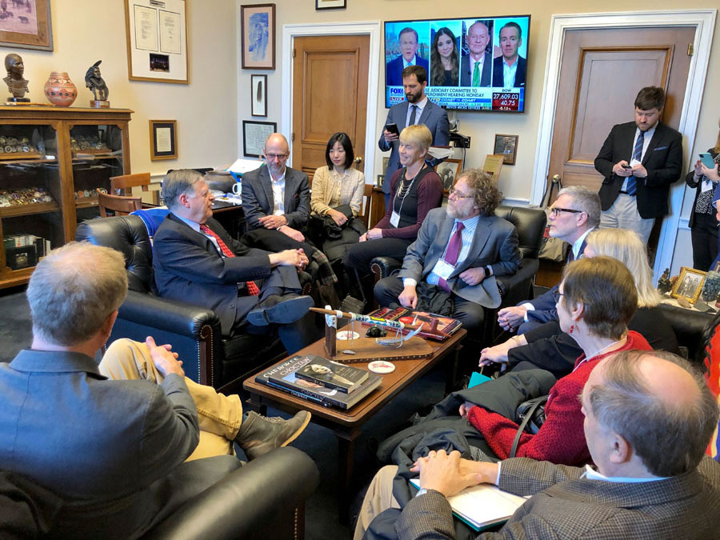
Introducing Yourself
Who I am + why I'm here
“Thank you for meeting with me/us today. I’m [name], with [program or university] in [town]. Our UCEDD/LEND program works with [population or partners] to [plain-language description]. I’m here today to tell you about the work that our program is doing in the [state/district] to serve people with disabilities. I'd also like to ask for [name of member]'s help with our federal policy priorities."
Note: You'll explain the details of the request later. Here you're just letting the staffer know that you'll be making a request.

Slide 20
Say It in Plain English
Don't assume that the staffers you're meeting with have ever heard of a UCEDD, LEND, IDDRC, the DD Act, etc. Even if they recognize the acronym, they might not know what the program does.
“Our center provides training, research, technical assistance, and community work to improve the lives of people with disabilities.”
“An interdisciplinary training program that prepares health and other professionals to serve children with developmental disabilities and their families.”
“We train the next generation of doctors, teachers, social workers, and attorneys to work with people with disabilities.”

Slide 21
What Does Your Program Actually Do?
Who does your program serve?
What are some examples of your program's work?
How does your program meet the particular needs of the member of Congress' district or state?
What are some outcomes that wouldn't have happened without your program?
What is a real story of someone impacted by your program?

Slide 22
Part 4 — Running the Meeting and Making the Ask
Structure, stories, and a clear request
Notes:
Breath. Part 4 is the meeting itself.

Slide 23
Anatomy of a 15-Minute Hill Meeting
Minutes 0–5 — Introductions: names, programs, and your state or district connection
(Ask the staff member questions to get to know them: what issues do they cover? Are they familiar with LEND, UCEDDs, IDDRCs?)
Minutes 5-7 — Tell your story: what your program does, who you serve, what makes your community unique.
Minutes 7-13 — Policy discussion: the issue, what’s happening, and the impact at home. Ask questions of the staffer: how familiar are they with these issues? What other information would be helpful? Is there a specific issue their boss is working on right now?
Minutes 13-15 — Make the ask, AUCD will provide you support in this with materials.
Minutes 15-20 — Questions, Allow the staff to ask questions, ask questions of the staff, and say thank you!

Slide 24

Tell Stories, Not Just Statistics
Data + program expertise + human impact: Your story with the data makes you memorable.
“Our program trained 300 providers last year” becomes real when you add what changed: families in rural counties who couldn’t find a qualified provider now can.
Keep stories relevant, concise, respectful, shared with consent, and tied to the policy issue.
Never let the story drift away from the ask.

Slide 25
Do NOT Spend the Whole Meeting Talking
The easiest and most forgettable meetings are those in which staff are talked at for the entirety of the time with no engagement.
Ask questions:
  What is your boss focused on for the remainder of the year?
  How can we help?
  What data is helpful as you present these issues to your boss?
  Are there issues impacting people with disabilities you and your boss are most interested in?

Slide 26
Part 5 — Navigating Capitol Hill
Buildings, security, timing, and what to expect
Notes:
Breath. Logistics next - this is where first-timers get burned.

Slide 27
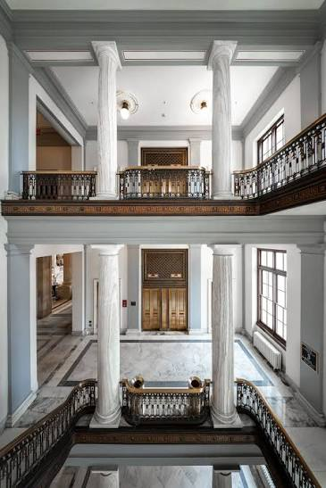
Capitol Hill Is Bigger Than It Looks
Plan the logistics, not just the message
The complex is large, and House and Senate buildings sit on opposite sides of the Capitol
Security screening takes time, and lines build during busy periods
Underground tunnels connect parts of the complex, but access varies
Your meetings may be in different buildings
Ordinary walking directions don’t reflect congressional building access
Build in more time than you think you need.
We strongly encourage splitting up your group: Have some people go to the House and have others focus on the Senate.
Meet after to discuss!
Notes:
Set expectations about how big the complex actually is. House and Senate are on opposite ends, security takes time, tunnels help but not always. Golden rule: give yourself more time than feels necessary.

Slide 28
What to Wear and Bring
General dress code: Business attire - suits, slacks, button up tops, blazers. Absolutely NO jeans, leggings/sweatpants, or t-shirts. Dress in layers. DC weather in November is unpredictable.
Comfortable shoes: Nice looking tennis shoes are OK, but we encourage dress shoes if they are comfortable. We do not recommend heels.
Things to avoid bringing: Anything you can’t get through airport security! Water bottles are OK. Large bags are not encouraged as you will be carrying them and there is limited space.
Metal Detector: You will go through a metal detector in each building. Keep items out of pockets while going through, remove coats. We do not recommend many loose items as it will slow you down.

Slide 29
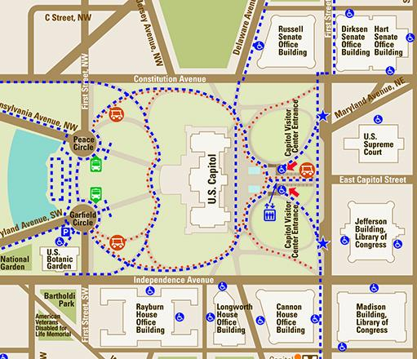
Capitol Complex

Slide 30
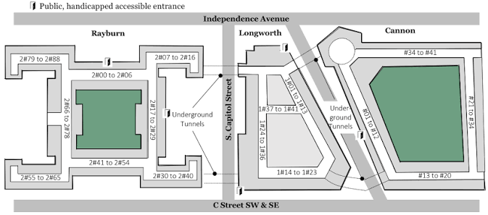
Finding the Office
House office buildings
Cannon: Rooms are always 3 digits. The first digit tells you the floor number.
Longworth: Rooms are four digits. 1 says it is Longworth. The second digit tells you the floor number
Rayburn: Rooms are 4 digits. 2 says it is Rayburn. Second digit tells you the floor number.
In the chat, tell me the building and floor of the following:
1278
325
2490

Slide 31
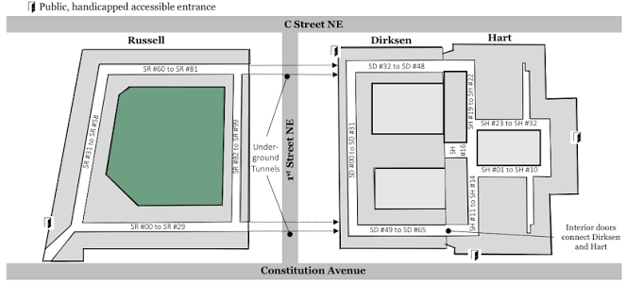
Finding the Office
Senate office buildings
Russell: SR prior to numbers tells you it is in the Russell building.
Dirksen: SD prior to numbers tells you it is in the Dirksen building.
Hart: SH prior to numbers tells you it is in the Hart building.
For all Senate office buildings: The first digit of the room number tells you the floor.
The building name and the room number both matter — confirm both before you go.
In the chat, tell me the building and floor of the following:
SH-440
SR-135
SD-328

Slide 32
Hill Math: Getting from House to Senate
Your meeting ends at 11:00. Your next meeting is at 11:30. Do you have time for a soda or coffee? Probably Not.
If you change buildings by going outside, you will need to go through metal detectors again.
Navigating the buildings is NOT intuitive or easy to understand. Give yourself time to find rooms.
We highly recommend breaking up your group into Team House and Team Senate: divide and conquer! This will allow you to take more meetings and be flexible in your schedule.
If you get lost, ask! People are busy but friendly. Ask a security guard, ask a staffer – they will help you find your next location.

Slide 33
You’ve Arrived. Now What?
The arrival sequence
Enter the building and clear security.
Find the elevator and locate the office.
Check in at reception with your name, organization, and meeting time.
Wait for staff, then begin.
Don’t arrive at the building at the exact time of your meeting!
When something goes wrong
The Member can’t attend — meet with staff (that is OK!).
Staff is running late — stay flexible.
The office cancels — ask whether another staffer can meet.
You’re lost — ask security, ask someone nearby, or call the office
You’re asked something you don’t know: NEVER pretend to know the answer. “I’m not sure” is always acceptable. You can tell them that you follow up with AUCD to get them the information. Never make up an answer!

Slide 34
The Meeting Isn’t Over When You Leave
Within 24–72 hours, send
  A thank-you note
  Any materials the office requested
  Answers to questions you couldn’t address in the room
  Relevant AUCD resources and your contact information
Record for next time (Send to Kim & Liz too!)
  Who you met with and what you discussed
  What the office said and what they committed to
  What you committed to, and your follow-up date
The goal isn’t one good meeting.
It’s an office that knows who you are and why your work matters.

Slide 35
Template Thank You
Subject: Follow-Up from Meeting with [name of center] on [date of meeting]
Hi [Staffer Name] –
Thank you for taking the time to meet with our center, [Center name]. We enjoyed meeting you and learning about [insert something the staffer shared].
I’ve attached the documents we shared in the meeting [ensure all are attached!]. In the meeting you requested [name information they requested]. I’ve also attached [name data, stories, etc. that were requested].
I hope to be a resource to you and your boss moving forward. I welcome ongoing conversation and would be happy to follow up in the new calendar year. Please let me know if you have other questions in the meantime. My phone number is [insert number].
Thanks,

Slide 36
Your Hill Visit Checklist
Before
Day of, and after
Identify your House and Senate offices
Request meetings early
Research the Members and know your local connection
Prepare your 60-second introduction
Assign roles for each person in your group, if others are joining you
Confirm meetings with the staffers
Prepare to meet with the state or center group going to the Hill at the AUCD conference BEFORE the day of meetings.
Bring contact information and arrive early
Allow time for security; know the building and room
Introduce yourselves, tell your story, explain the issue
Make the ask, invite questions, confirm follow-up
Send a thank-you and the requested materials
Record commitments, update AUCD, and keep the relationship going

Slide 37
Questions?

