Slide 1
Pre-Application
Webinar
Notes:
Hello and Welcome-- Emily

Slide 2
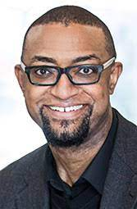
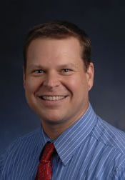
Center for Leadership in Disability
Leadership Academy Team
Matthew Wesley Williams is the Senior Vice President of Community Development, Marketing and Communications at Groundswell Community Power and Principal at Liberating Leadership.
Dr. Andy Roach, PhD is a Professor in the Department of Counseling and Psychological Services and Program Coordinator of the college’s School Psychology PhD Program at Georgia State University.

Slide 3
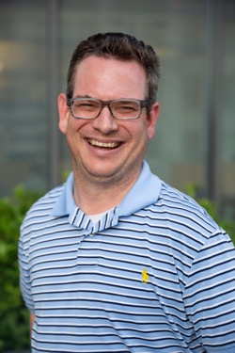
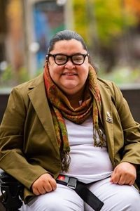
Center for Leadership in Disability
Leadership Academy Team
Mark Crenshaw is the Director of Interdisciplinary Training at the Center for Leadership in Disability at Georgia State University.
Jeiri Flores is an Advocacy Specialist at the Strong Center for Developmental Disabilities and Co-Advocacy Discipline Coordinator for the Rochester LEND.

Slide 4
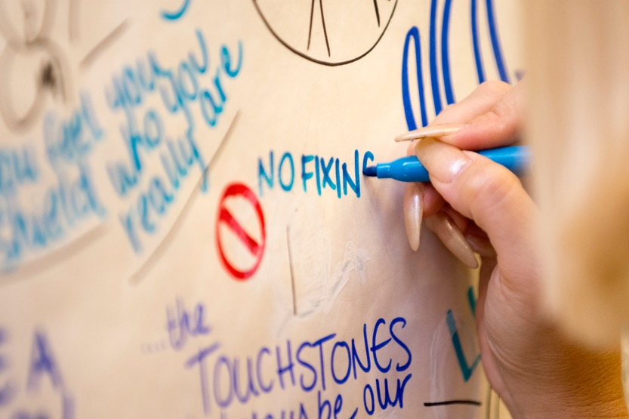
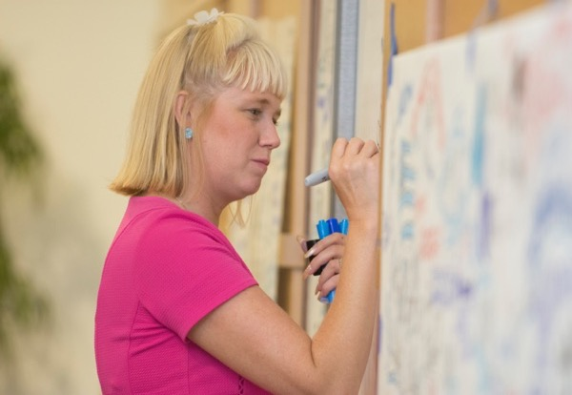
Center for Leadership in Disability
Leadership Academy Team
Graphic Facilitation By Inky Brittany—Brittany Curry

Slide 5
Graphic Facilitation by Brittany Curry

Slide 6

What we’ll talk about today…
1. What will participants learn? (Red)
2. How will participants learn? (Orange)
3. What do past participants say about the Experience? (Green)
4. How do you apply? (Blue)
5. Questions and Answers (Purple)
Notes:
Mark Previews

Slide 7
The next set of slides will answer….
What do participants learn?
Notes:
Red Slides--Mark

Slide 8
History of Disability Rights Movement
Experiential activities and guest speakers to introduce participants to the following topics:
History of disability rights and independent living movements
Evolution of disability policy and advocacy
Current issues in national and state policy
Support to develop a vision for participant’s unique contributions to work within their organization

Slide 9
Courage & Renewal and Circle of Trust
  Courage & Renewal and Circle of Trust as an organizing framework:
  Rooted in community organizing with historically disenfranchised groups
Provides a forum for exploring leadership identity, personal/professional growth, organization values and culture, and sustaining effort toward addressing complex social issues
Has a 25+ year history of utilization with cohorts of emergent and established leaders
Supports participants’ resilience and commitment to creating a community that recognizes and honors difference and diversity

Slide 10
Intersectional Frameworks for Collective Action
We will have presentations and group activities with leaders of UCEDDs and other disability organizations featuring:
Examples of successful partnerships that addressed multiple organizations and perspectives – universities, community partners, advocacy organizations, and provider agencies
Illustrations of one of the tenets of Courage & Renewal that leadership involves “creating the space where people can discover and enact their gifts and resources”

Slide 11
Strengths Based Leadership
VIA – Values in Action
  An assessment of 24 character strengths – describing “who you are” in everyday language
  https://www.viacharacter.org/www/Character-Strengths/The-Science-of-Character-Video
  All participants (and faculty) will complete the VIA prior to the academy.
  We will review the findings from the VIA and discuss them in small groups
  Assessments will create a shared vocabulary to discuss strengths

Slide 12
We just discussed:
History of disability rights movement
Self-reflection via Courage & Renewal and Circles of Trust approaches
The importance of building community alliances
Leadership strengths assessment- VIA-Values In Action
What will participants learn?

Slide 13
The next set of slides will answer….
How will participants learn?
Notes:
Orange Slides-- Ray

Slide 14
Universal Design for Learning
Multiple means of
  Representation
  Action and expression
  Engagement
Accessible print materials – key points highlighted at accessible reading levels
Informational resources in print, video, and audio
Graphic facilitator(s) during presentations and selected small group sessions

Slide 15
Cultural and Linguistic Competence
Faculty and participants from diverse backgrounds, perspectives, and lived experiences
Provide support for participants’ resilience and commitment to create a community of leaders and advocates that recognizes and honors difference and diversity

Slide 16
Experiential Learning
A slower pace for learning and reflection
Small group discussion and problem-solving
Time with faculty and peers for dialogue and exploration
Participants help develop schedule of follow-up activities and presentations
Year-long coaching and discussions with leadership allies

Slide 17
Self-reflection Ally Groups
Groups supporting self-reflection (i.e., ally groups) will be formed during the academy week
Ally groups will meet every other month over the course of the year following the academy week
  Ally groups will be facilitated by a Leadership Academy Faculty member

Slide 18
Leadership Coaches
Leadership coaches will support participants in the translating Academy leadership commitments and skills into action in their home organizations
Coaches will meet formally face-to-face with participants 6 times in the year following the in-person training in Atlanta.
  At least two of these sessions will include observations: one where participant observes the coach and the other where coach observes participant.
  Participants will be responsible for the content of four additional meetings to discuss progress toward a self-identified leadership goal developed during the Academy.

Slide 19
Universal Design for Learning
Graphic Facilitation
Cultural and Linguistic Competence
Experiential Learning
Self-reflection Ally Groups
Leadership Coaches
We just discussed:
How participants will learn?

Slide 20
The next set of slides will answer…
What do AUCD Leadership Academy Participants say about the experience?
Academy Schedule
Notes:
Green Slides--Mark

Slide 21

Jeiri Flores (‘18)
Jeiri Flores is Advocacy Specialist and LEND Self-Advocacy Co-Discipline Coordinator at the Strong Center for Developmental Disabilities. Jeiri is a sought-after writer, speaker, teacher, facilitator, podcast guest and advocate. She has been featured in outlets like Time and the blogs of the Christopher and Diana Reeve Foundation and the Association of University Centers on Disability. Jeiri recently completed a term as a member of the Board of Directors for the Association of University Centers on Disability (AUCD). During her time on the board, she also served as Co-Chair of the AUCD’s Council on Leadership and Advocacy. She continues to serve on this committee where she amplifies the voices of disabled people, especially those from underserved and too often invisible minority communities. Jeiri’s service to AUCD also includes serving as host of the Network Narratives Podcast, now in season 2, where she interviews disabled and nondisabled network leaders who are leading research and model service demonstration work with the goal of strengthening their communities with people with disabilities and their families.

Slide 22
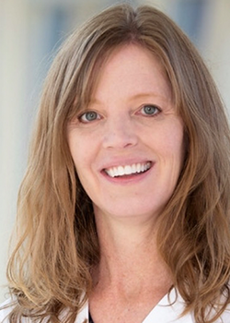
Megan Roberts (‘17)
Megan Roberts, PT, DsC is a Clinical Associate Professor and of Director of the Oklahoma LEND.-- Oklahoma Leadership Education in Neurodevelopmental and Related Disabilities (LEND).Megan was recently awarded the University of Oklahoma 2024 Interprofessional Educators and Practitioners Association (IEPA) Leader of the Year award. Dr. Roberts is a dynamic force in disability advocacy and education. Megan’s influence extends globally as she has mentored eight Professional Fellows from Kenya, Uganda, and Tanzania through the Professional Fellows Programs in Inclusive Disability Employment and Inclusive Civic Engagement, sponsored by the U.S. Department of State Bureau of Educational and Cultural Affairs. Dr. Roberts provides technical assistance to improve disability-related systems, policies, and services at local, state, and national levels. Her dedication continues to drive positive change in the field

Slide 23
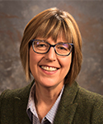
Michelle Jarman (‘24)
Michelle Jarman is the Director of The Wyoming Institute for Disabilities, Wyoming’s UCEDD. She also is a Professor of Disability Studies and the current Director of Gender and Women’s Studies in the School of Culture, Gender and Social Justice. In addition to ongoing service activities within the College of Health Sciences, Michelle serves on the University’s Inclusion Council. Her research interests include 20th-century U.S. literature and intersecting cultural representations of disability, gender, and race. Current research focuses on community-based participatory projects, disability memoirs, and reproductive justice. Her scholarship has appeared in journals such as Disability Studies Quarterly, Feminist Formations, the Journal of American Culture, and in prominent literary and disability studies anthologies. She is currently working on a book manuscript titled Crip Relations: Intersectionality and Interdependence in Disability Memoirs.

Slide 24
Year At-a-Glance
Application Phase
November 2024 | Application Available
March 3, 2025 | Application Deadline
March 24, 2025 | Initial Acceptances
April 3, 2025 | Final Applicant Notifications

Slide 25
Year At-a-Glance
2025 AUCD Leadership Academy Activities
3 Pre-Academy Webinars | April & May 2025 (60-75 Minutes
In-Residence Academy Session in Atlanta | June 1-6, 2025
Post-Academy Ally Group Meetings | September 2025-April 2026
Local Leadership Coaching Sessions | October 2025-May of 2026

Slide 26
AUCD Leadership Academy
  Sunday, June 1th
    Arrive - 3:00 to 3:45 pm
    Opening session at 4:00 pm
    Dinner provided
    Conclude by 7:30 pm
  June 2nd - June 5th (Daily Schedule)
    Previewing the day - 8:30 am
    Coffee / Networking - 9:00 to 9:45 am
    Opening session - 10:00 am
    Conclude between 6:00 and 6:30 pm
  June 6th
    Depart by 3:00pm
  Other Highlights / Additions
    Breakfast available everyday (6/2-6/6)
    Lunch provided on June 2th & June 5th
    Dinner provided June 1st & June 5th

Slide 27
Perspectives from three Alumni
In-person Academy Schedule
Pre-Academy Webinars
Post-Academy Activities
We just discussed:
How will participants learn?

Slide 28
The next set of slides will answer….
Who should apply?
- How do I apply?
Notes:
Blue Slides-Ray

Slide 29
Who should apply?

Slide 30
Who should apply?
24 participants
Diverse participant cohort
Target audiences include
  Faculty and staff of UCEDDs and LENDs
  Current and emerging leaders of state and national disability organizations
  Other community and university partners

Slide 31
How do I apply?
Submit your application through the application portal: https://scholarworks.gsu.edu/aucdleadacademy/ or download a word version of the application here: https://cld.gsu.edu/academy
Completed application will include:
  Current resume or curriculum vitae
  Letter of support from senior organizational or agency representative
  250-word biographical statement

Slide 32
Supports
If you need any support completing your application, please reach out to Mark Crenshaw (mcrenshaw@gsu.edu).

Slide 33
How to apply for the 2025 AUCD Leadership Academy
Review of the components of a complete application
What to do if you need support completing your application
We just discussed:
Who are participants?

Slide 34
What questions do you have?….
Questions & Answers

Slide 35
Today we talked about…
What do participants learn? (Red)
How do participants learn? (Orange)
What did past participants gain from the experience? (Green)
How do I apply? (Blue)
Questions & Answers? (Purple)

Slide 36
Contacts
Mailing Address
Center for Leadership in Disability at Georgia State University
140 Decatur St. SE, Suite 140
Atlanta, GA 30303
Email Address
aucdacademy@gsu.edu
Website
cld.gsu.edu
Phone Number
(404) 413-9334

