Slide 1
Community Education & Dissemination Council (CEDC)
In the chat, tell us:
Something you’re looking forward to this summer
May 2026, Quarterly Meeting

Slide 2
Agenda
Welcome (5 minutes)
Introductions (5 minutes)
New CEDC Business & Announcements (5 minutes)
-Reminder: CEDC on chair vacancy
CEDC Professional Development Committee Updates (5 minutes)
-PD Committee recruitment and update - Speaker Series
Shoutout Corner – Any attendee (5 minutes)
Break (5min)
Information Sharing & Network Spotlights (25 minutes) Begins at 12:30
Closing Remarks & Future Meetings (5 minutes)

Slide 3
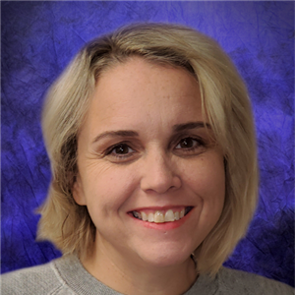
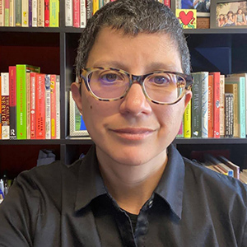

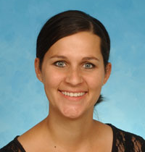
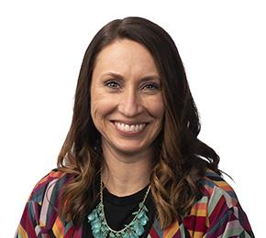
Our Leadership Team
Miranda Hooper
CEDC Vice Chair
University of Oklahoma Center for Learning and Leadership | OK UCEDD
miranda-hooper@ou.edu
Anna Costales
Staff Liaison
Association of University Centers on Disabilities
acostales@aucd.org
Vacant
CEDC Chair
Amy Burt
CEDC Secretary
West Virginia University Center for Excellence in Disabilities
alburt@hsc.wvu.edu
Aimee Deliramich
PD Committee Chair
University of South Dakota Center for Disabilities
aimee.deliramich@usd.edu

Slide 4
New CEDC Business & Announcements: Chair Vacancy and Action Plan
CEDC Chair: Vacant (reminder)
Padlet Resources: https://tinyurl.com/padletCEDC
Interested in serving? Let us know!
Mentoring by established CEDC team
Three year term
Notes:
Padlet Resources: https://tinyurl.com/CEDCPadlet
CEDC Webpage: https://www.aucd.org/cedc

Slide 5
New CEDC Business & Announcements: Attendance & Reach
68 Attendees for February Quarterly Meeting (10+min)
38 Attendees for March Coffee Chat (10+min)
Reach map will be available next Quarterly meeting

Slide 6
CEDC Professional Development Committee Updates
PD Recruitment and update - speaker series
Occur on 3rd Thursdays 12-1pm EST on months there is no Quarterly meeting
3-Part Series - Access for All: Building Digital and Document Accessibility Series
- Current: PowerPoint and Presentation Accessibility: Making Slides Accessible for All
- Previous: Word and PDF documents
See bottom of agenda for details on all Coffee Chat and Quarterly Meetings
Reach out if interested in joining the PD committee: (Aimee.Deliramich@usd.edu)

Slide 7

Shoutout Corner - Any Attendee
We want to know:
What’s going on at your Center or Program?

Slide 8

Break
Guest Speaker will begin at 12:30pm. As a reminder, this section will be recorded.

Slide 9

Information Sharing and Network Spotlights (Recorded)
PowerPoint and Presentation Accessibility: Making Slides Accessible for All
Sessions include:
✔️ Introduction to Presentation Accessibility (Today)
✔️ Hands-on Accessible PowerPoint Workshop (June)
✔️ Reflection & Discussion on Challenges and Successes (July)

Slide 10
Closing Remarks and Future 2026 Meetings
Quarterly meetings and Coffee Chats occur on the third Thursday at 12:00-1:00 EST
June 18 Coffee Chat
July 16 Coffee Chat
August 20 Quarterly Meeting
Sept. 17 Coffee Chat
Oct. 15 Coffee Chat
November (TBD) Quarterly Meeting | AUCD Conference

Slide 11
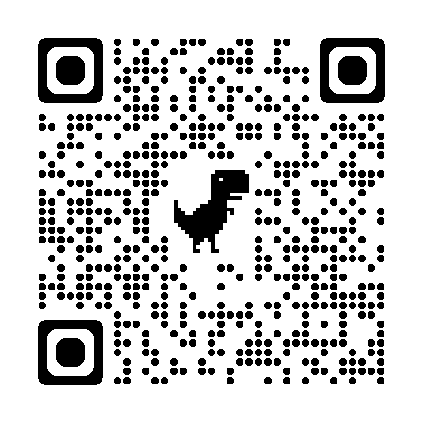
Subscribe to the listserv

