Slide 1
Community Education & Dissemination Council (CEDC)
In the chat, tell us:
Something fun you did this summer
August 2026, Quarterly Meeting

Slide 2
Agenda
Welcome (5 minutes)
Introductions (5 minutes)
New CEDC Business & Announcements (5 minutes)
-Reminder: CEDC on chair vacancy
CEDC Professional Development Committee Updates (5 minutes)
-PD Committee recruitment and update - Speaker Series
Shoutout Corner – Any attendee (5 minutes)
Break (5min)
Information Sharing & Network Spotlights (25 minutes) Begins at 12:30
Closing Remarks & Future Meetings (5 minutes)

Slide 3
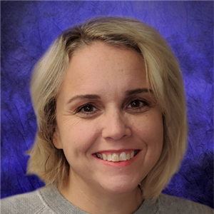
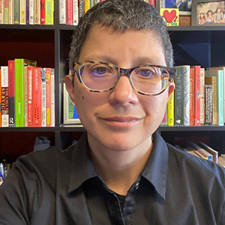

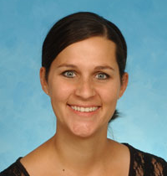
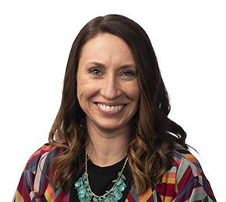
Our Leadership Team
Miranda Hooper
CEDC Vice Chair
University of Oklahoma Center for Learning and Leadership | OK UCEDD
miranda-hooper@ou.edu
Anna Costales
Staff Liaison
Association of University Centers on Disabilities
acostales@aucd.org
Vacant
CEDC Chair
Amy Burt
CEDC Secretary
West Virginia University Center for Excellence in Disabilities
alburt@hsc.wvu.edu
Aimee Deliramich
PD Committee Chair
University of South Dakota Center for Disabilities
aimee.deliramich@usd.edu

Slide 4
New CEDC Business & Announcements: Chair Vacancy and Action Plan
CEDC Chair: Vacant (reminder)
Padlet Resources: https://tinyurl.com/padletCEDC
Interested in serving? Let us know!
-Mentoring by established CEDC team
-Three year term
-Includes Board participation
-Must have permission from supervisor as this is a time and travel commitment
Developing: CEDC in-person Council meeting at AUCD Conference Nov 2026
Notes:
Padlet Resources: https://tinyurl.com/CEDCPadlet
CEDC Webpage: https://www.aucd.org/cedc

Slide 5
CEDC Professional Development Committee Updates
Occur on 3rd Thursdays 12-1pm EST on months there is no Quarterly meeting
3-Part Series - Access for All: Building Digital and Document Accessibility Series
- Current:Social Media Accessibility: Creating Inclusive Online Content
- Previous: PowerPoint and Presentation Accessibility: Making Slides Accessible for All
- Previous: Word and PDF documents
View Event Page for CEDC Access for All: Building Digital and Document Accessibility Skills – Social Media Accessibility: Creating Inclusive Online Content
See bottom of agenda for details on all Coffee Chat and Quarterly Meetings
Reach out if interested in joining the PD committee: (Aimee.Deliramich@usd.edu)

Slide 6

Shoutout Corner - Any Attendee
We want to know:
What’s going on at your Center or Program?

Slide 7

Break
Guest Speaker will begin at 12:30pm. As a reminder, this section will be recorded.

Slide 8
Information Sharing and Network Spotlights (Recorded)
Access for All: Building Digital and Document Accessibility Skills Series
Part 3 of three-part series: Social Media Accessibility: Creating Inclusive Online Content.
Feature Speaker for Part 3: Dr. Hillary Goldthwait-Fowles, ATP
Instructional Design Specialist — Kennedy Krieger
RESNA-certified Assistive Technology Professional
30+ years in education

Slide 9
Closing Remarks and Future 2026 Meetings
Quarterly meetings and Coffee Chats occur on the third Thursday at 12:00-1:00 EST
Sept. 17 Coffee Chat
Oct. 15 Coffee Chat
November (TBD) Quarterly Meeting | AUCD Conference

Slide 10
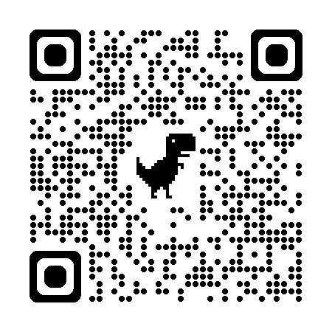
Subscribe to the listserv

