Slide 1
ODEP
Expanding Apprenticeship Opportunities for People with Disabilities, including Intellectual and Developmental Disabilities:
The Apprenticeship Inclusion Models (AIM)
Initiative National Conference of the Association of University Centers on Disabilities (AUCD) | Washington, DC
Monday, November 18, 2019

Slide 2
Presenters: ODEP
Carolyn Jones, MBA (moderator)
Senior Policy Advisor
U.S. Department of Labor
Office of Disability Employment Policy
Youth Policy Team
Scott Michael Robertson, PhD
Policy Advisor
U.S. Department of Labor
Office of Disability Employment Policy
Employment-Related Supports Policy Team

Slide 3
Presenters: JFF and Wheelhouse
Tom Hooper, MPA
Associate Vice President
Jobs for the Future (JFF)
Josh Christianson, MS
Senior Consultant,
Wheelhouse Group

Slide 4
Learning Objectives
Define apprenticeship, Registered Apprenticeship, and pre-apprenticeship
Discuss the Apprenticeship Inclusion Models (AIM) initiative
Describe how apprenticeship supports opportunities for people with intellectual and developmental disabilities
Differentiate accessible workplace technology and assistive technology

Slide 5
Introductory Remarks
Carolyn Jones
ODEP

Slide 6
Office of Disability Employment Policy (ODEP)
ODEP is the only non-regulatory federal agency that promotes policies and coordinates with employers and all levels of government to increase workplace success for people with disabilities.
https://www.dol.gov/odep/

Slide 7
The AIM Initiative
Tom Hooper
JFF

Slide 8
AIM: The Activities
Provide training and technical assistance at four pilot sites to test new, innovative approaches to apprenticeship.
Collect data, learnings, and promising practices to share with pilot sites and the wider community.
Host a broad Community of Practice that enables stakeholders to contribute expertise.

Slide 9
The Value of Work-Based Learning
Exposes participants to the world of work
Exposes participants to a career field
Strengthens academic learning
Enhances professional skills
Provides a temporary/ permanent job

Slide 10
Defining Some Terms
Registered Apprenticeship (RA):
An apprenticeship program approved by either the U.S. Department of Labor’s Office of Apprenticeship or by a State Apprenticeship Agency.
RAs last from 1 to 6 years and are sponsored by employers, labor management organizations, or other intermediary organizations.
They must include the basic elements that are common to all apprenticeships, but they also have to meet several additional quality requirements.
Recognition as an RA requires a program to provide approximately 2,000 hours of on-the-job learning and 144 hours of related instruction that applies to an occupation or a specific job.
Participants in RA programs receive on-the-job supervision and mentorship
They are paid increasingly higher wages as they progress through their training and earn industry-recognized credentials upon successful completion of the program.

Slide 11
Defining Some Terms
Pre-Apprenticeship:
A program designed to prepare individuals to enter and succeed in RA or other high-quality apprenticeship programs, and ultimately enter careers.
Pre-apprenticeship programs are not federally vetted
A high-quality pre-apprenticeship would have a strong relationship with at least one apprenticeship program
It would feature training and a curriculum aligning with that program and including a wide range of support services designed specifically to help participants succeed.
For more information on these and other WBL terms please visit:
https://center4apprenticeship.jff.org/work-based-learning/work-based-learning-glossary/

Slide 12
The AIM Pilots
Partners:
Microsoft (Apprenti)
Amazon (Apprenti)
Healthcare Career Advancement Program (H-CAP)
Industrial Manufacturing Technician Apprenticeship Program (IMT)
Serve over 500+ youth and adults

Slide 13
The Pilots: Amazon, IMT
Pilot site | Anticipated outcomes/lessons learned
Amazon Registered Apprenticeship | Improve understanding of the transitional process for Veterans re-entering the workplace in IT, including software development Broaden supportive services to address the needs of Veterans with disabilities Create protocols to ensure inclusive work environments for people with disabilities
Industrial Manufacturing Tech. (IMT) Apprenticeship Program Pre-Apprenticeship | Expand entry into manufacturing careers for people with learning disabilities Develop and implement IMTFolio, a tech solution that assesses readiness for the IMT apprenticeship and mastery of key competencies vs traditional, one-time, one-size-fits-all tests that can be a barrier to entry Pilot IMTFolio in IMT’s WI and MN pre-app programs that articulate to the IMT Registered Apprenticeship

Slide 14
The Pilots: Microsoft, H-CAP
Pilot site | Anticipated outcomes/lessons learned
Microsoft Registered Apprenticeship | Review existing services for supporting workers with disabilities Explore best practices and opportunities within existing training efforts for individuals on the Autism spectrum Support youth with disabilities in developing competitive skills in IT
Healthcare Career Advancement Program (H-CAP) Registered Apprenticeship, Pre-Apprenticeship | Research and map career ladders and eligibility requirements to help people with disabilities pursuing careers in HC via apprenticeship in Phil. and NYC Identify and document ways employers currently engage with community partners and supportive services to create more inclusive workplaces Provide supplementary resources in mentorship and braided funding for healthcare intermediaries and training providers

Slide 15
Resource & TA Offerings
TA for Pilots:
1:1 Site Offerings
TA for Pilots:
Group TA
Sites work with coaches to determine specific site-level goals and related technical assistance activities
Sites have ongoing, monthly coaching calls to track progress, schedule technical assistance interventions, and evaluate progress towards goals
Trainings and resources are delivered to address needs shared by the whole cohort
Peer networking opportunities such as facilitated calls, webinars and in-person events

Slide 16
Resource & TA Offerings (Cont.)
TA for Interested Stakeholders:
Individuals outside the pilots can receive invitations to webinars, access to a Resource Library with tools and other resources, and e-mail updates
Opportunities for interested stakeholders to join a CoP and have access to resources produced for the pilots

Slide 17
Expanding Career Pathways for People with Disabilities
Apprenticeship Inclusion Models (AIM) Initiative
Related Resources
Partnership on Employment and Accessible Technology (PEAT): www.peatworks.org
Center for Apprenticeship & Work-Based Learning Center4Apprenticeship.jff.org
Partnership for Youth Apprenticeship (PAYA) www.newamerica.org/paya
https://www.spra.com/aim/

Slide 18
Apprenticeship Access for People with Intellectual and Developmental Disabilities (I/DD)
Scott Michael Robertson
ODEP

Slide 19
Inclusive Apprenticeship Offers Value for Youth and Adults with I/DD
Enhanced approach to foster gainful employment
Widespread employment barriers among people with I/DD—especially individuals receiving DD services
Insufficient opportunities for pursuing postsecondary education after high school exit
Recognized career pathway with credentialing
Connected to career and technical education (CTE)
Flexible and customizable for support systems
Adopting the earn-and-learn model=access by youth and adults from lower socio-economic status

Slide 20
Apprenticeship Supports for Youth and Adults with I/DD Include…
Coaching, mentoring, and team buddies
Training for employers and service providers on I/DD and cognitive disabilities overall
Supports for transportation to job sites and instructional (classroom) sites
Accessible technology and Universal Design (UD)
Adjustments and accommodations for differences in communication, sensory processing, etc.

Slide 21
Spotlighting Autism and Neurodiversity in Apprenticeship
Emphasis on a neurological developmental disability with a prevalence of 1-2% (children, youth, and adults)
Autism CARES Act of 2019
Expanded prioritization on lifespan research and supports
Addition of DOL, HUD, DOJ, and VA to the Interagency Autism Coordinating Committee (IACC)
Natural fit for on-the-job training and related classroom learning associated with inclusive apprenticeship
Job training and classroom instruction tied to interests
Structured supports and scaffolding
Customization for inclusive apprenticeship (adaptable)

Slide 22
Prior DOL Initiatives for Autism and On-the-Job Training Include…
Managing the Talent Pipeline in Health Information program
American Apprenticeship program (~$5 million/5 yrs.)
Track for job seekers on the autism spectrum
Next Step Job Training and Employment Partnership
Tech Hire program (~$4M/5 yrs.)
Goal of supporting 450 job seekers on the autism spectrum
Focus on healthcare and IT fields
Boot camps for workplace communication and independent living skill development

Slide 23
Accessible Workplace Technology and Universal Design (UD)
Josh Christianson
Wheelhouse Group

Slide 24
Concluding Remarks
Carolyn Jones
ODEP

Slide 25
Questions/Answers

Slide 26
Resources
Work-based Learning and Inclusive Apprenticeship

Slide 27
Apprenticeship Videos and Toolkit
#ApprenticeshipWorks Video Series: Video series featuring youth apprentices with and without disabilities and their employer sponsors [need URL]
Apprenticeship Toolkit: Tool to help establish apprenticeship programs and support employer engagement for young adults with disabilities dol.gov/odep/topics/youth/Apprenticeship.htm

Slide 28
Apprenticeship Finder and Task Force Report
Apprenticeship Finder: Web portal for employers, job seekers, educators, and community-based agencies to promote apprenticeship opportunities https://www.apprenticeship.gov
Task Force on Apprenticeship Expansion Final Report: https://www.dol.gov/apprenticeship/docs/task-force-apprenticeship-expansion-report.pdf

Slide 29
Business 30-Second Trainings: Recruitment and Hiring Strategies
Why should I hire a person with a disability?
How can I find qualified employment candidates with disabilities?
What questions can I ask when interviewing an applicant with a disability?
What is a State Vocational Rehabilitation Agency and how can it help me?
Where can I find common myths and facts about Employers and the ADA?
https://dei.workforcegps.org/resources/2017/12/06/13/59/Business_30-Second_Trainings_Recruitment_and_Hiring_Strategies

Slide 30
Data and Resources to Inspire a Vison of Employment (think about…
DRIVE launched in 2015 by ODEP provides a national and state-by-state profiles of data points, polices, and practices related to:
Improving employment opportunities for people with disabilities
Workforce Innovation and Opportunity Act (WIOA) implementation profiles
Specific information on school-to-work transition plans; and
Related programs for students with disabilities. www.drivedisabilityemployment.org

Slide 31
Apprenticeship EEO Tools and Resources
Apprenticeship EEO FAQs: Overview of what sponsors need to know regarding the Apprenticeship EEO regulations: https://www.doleta.gov/oa/eeo/pdf/FAQs.pdf
Apprenticeship EEO Video: Information on what sponsors need to know regarding compliance: http://mahernet.adobeconnect.com/p96txksu3gnn

Slide 32
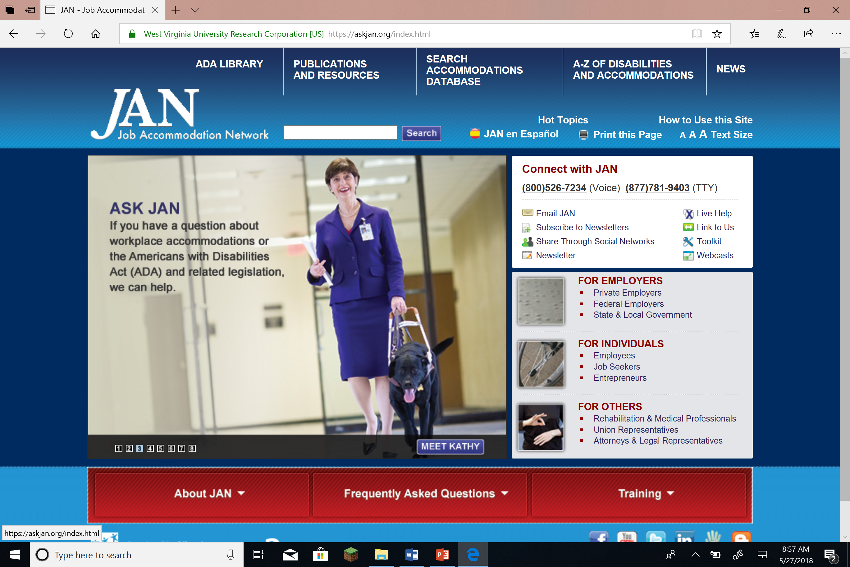
JAN
JAN logo
Leading source of free, expert and confidential guidance on workplace accommodations
AskJAN.org
(800) 526-7234 (Voice)
(877) 781-9403 (TTY)
Text to (304) 216-8189
Skype with janconsultants
Live chat
Snapshot of JAN’s website
Notes:
Will want to change screen shot when new JAN Home page is implemented

Slide 33
Resources
Postsecondary Transition

Slide 34
Secondary and Postsecondary Resources
The 411 on Disability Disclosure: Workbook to support self-disclosure and learning rights and responsibilities under the law
http://www.ncwd-youth.info/411-on-disability-disclosure
Skills to Pay the Bills: Free employability skills curriculum developed by ODEP for youth development professionals https://www.dol.gov/odep/topics/youth/softskills/softskills.pdf

Slide 35
Secondary and Postsecondary Resources
National Center for College Students with Disabilities, a federally funded TA center for college students with disabilities, parents and families, and educators
http://www.nccsdonline.org

Slide 36
Resources
Autism

Slide 37
Resources on Autism and Employment
ODEP Topic Resources Webpage on Autism: https://www.dol.gov/odep/topics/Autism.htm
JAN’s Info Resources on Autism:
Accommodation Series on Autism: https://askjan.org/disabilities/Autism-Spectrum.cfm?cssearch=1909520_1
Interviewing Tips for Job Seekers: https://askjan.org/publications/consultants-corner/vol10iss01.cfm
Autism @ Work Playbook from Disability:IN’s Autism @ Work Employer Roundtable: http://disabilityin.org/resources/autism-work-playbook/

Slide 38
Contact Information
Carolyn Jones, Senior Policy Advisor, Youth Team, ODEP Jones.Carolyn@dol.gov
Scott Michael Robertson, PhD, Policy Advisor, ERS Team, ODEP Robertson.Scott.M@dol.gov
Tom Hooper, MPA, Vice President, JFF THooper@jff.org
Josh Christianson, Senior Consultant, Wheelhouse Group Josh.Christianson@wheelhousegroup.com

