Slide 1
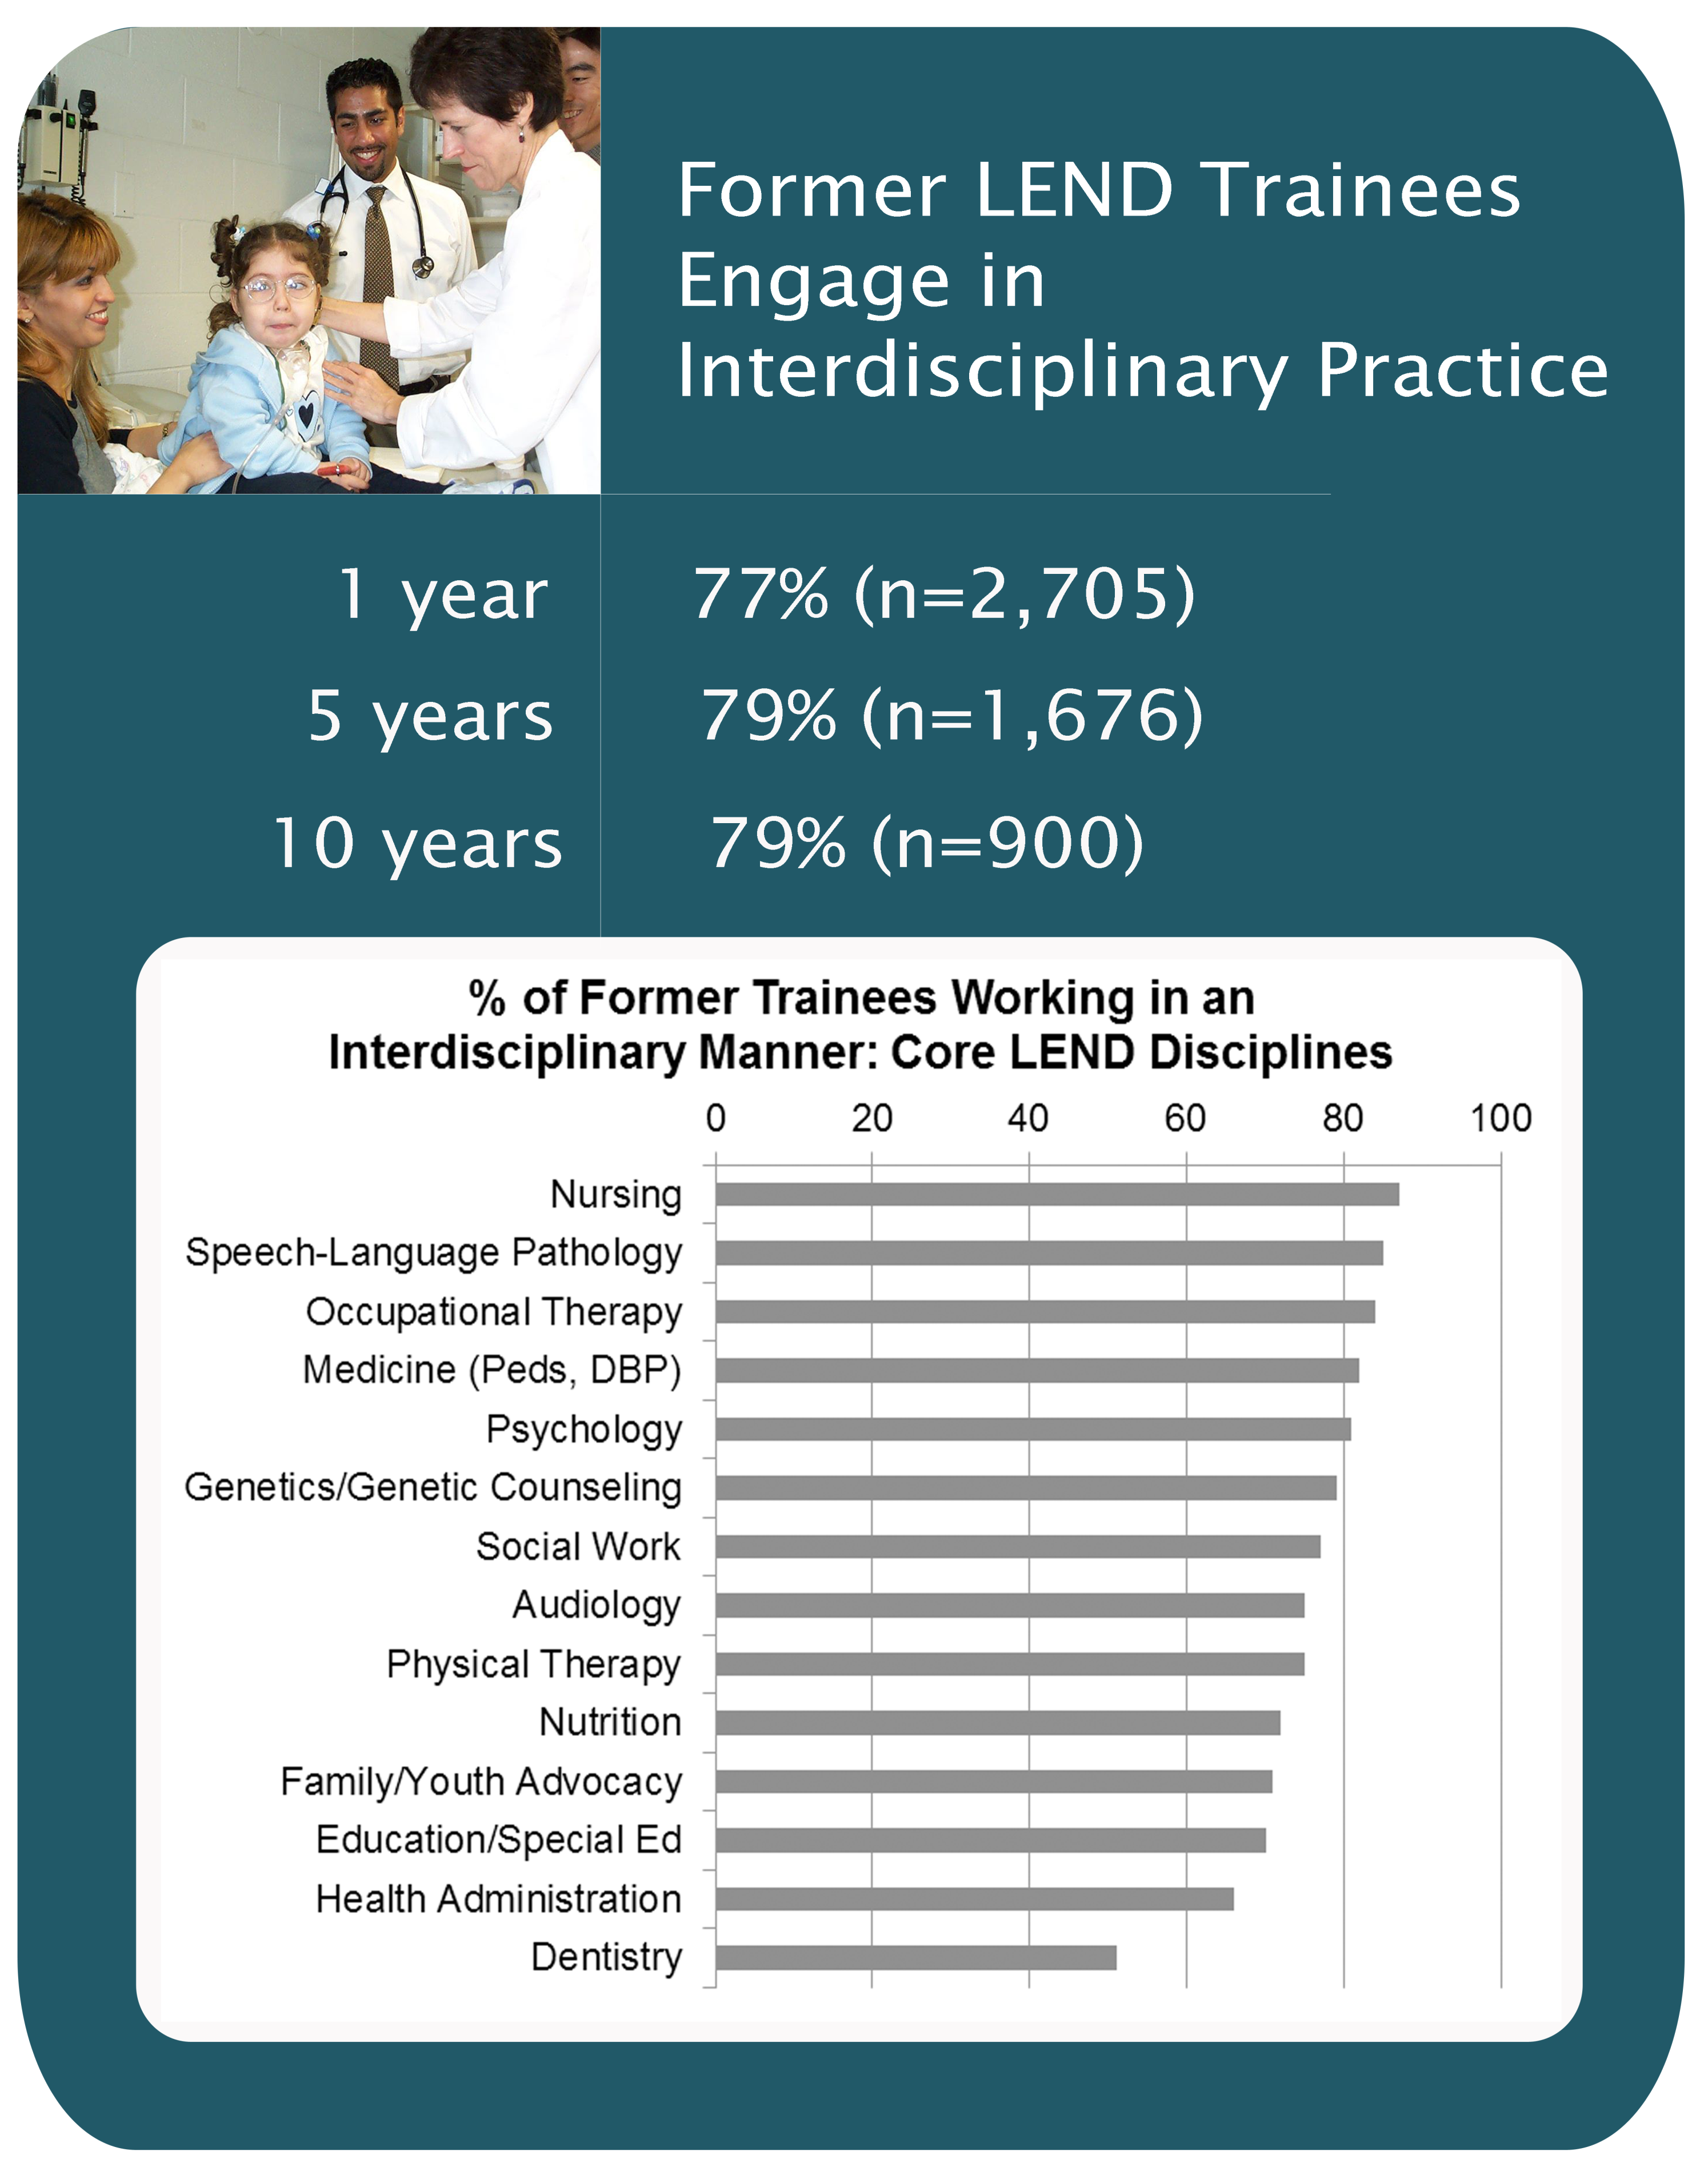
LEND Trainee Leadership Outcomes: THE DATA STORY
Pariseau, C; Perry, J; Miclea-Rotsko, C.
The development of this poster was supported by the Association of University Centers on Disabilities (AUCD) through a cooperative agreement with the Health Resources and Services Administration’s Maternal and Child Health Bureau (MCHB), grant #UA5MC11068.
Conclusions & Implications With over 1,200 long-term trainees per year, LEND training programs have an unparalleled opportunity to impact future health and public health professionals. The vast majority (90-94%) of former LEND trainees surveyed at 1, 5, and 10 years post-training demonstrate leadership in their respective fields. Clinical and academic leadership are seen most often, with the greatest increase over time in the domain of clinical leadership. Close to 80% of LEND trainees are working in an interdisciplinary manner post-training and approximately 80% also report working with underserved populations across 52 US states and territories and internationally in 14 countries. Based on this data, former LEND trainees overall report high and sustained levels of leadership, interdisciplinary practice, and work with underserved populations. LEND training programs can serve as models for successful MCH workforce development.
Some areas for additional consideration highlighted by this examination of former LEND trainee survey data are as follows:
Participation in public health and policy/advocacy leadership activities was reported less frequently than leadership in the clinical and academic domains. Given MCHB’s interest in strengthening the public health workforce and the emerging changes in the US health care system, greater emphasis might be placed on helping future trainees develop additional skills and an understanding of potential opportunities to demonstrate leadership in public health and policy/advocacy areas.
Variability is reported among the core disciplines in the extent to which working in an interdisciplinary manner is reported by former trainees. There may be a need for increased emphasis on interdisciplinary collaboration in the training and practice of some professional disciplines to meet the present and emerging needs of the MCH population.
While former LEND trainees are working in underserved locations across the US, there is clearly a maldistribution of these MCH professionals. Strategies to increase recruitment and retention of former LEND trainees in underserved areas should be a priority.
Characteristics of those former trainees who do not go on to achieve long-terms outcomes of importance to MCHB and LEND may be a topic for further study.
About LEND Leadership Education in Neurodevelopmental and Related Disabilities (LEND) programs, funded by HRSA’s Maternal and Child Health Bureau (MCHB), provide long-term, graduate level interdisciplinary training as well as interdisciplinary services and care to children with special health care needs and their families. 43 LENDs in 37 states work to improve the health of infants, children, and adolescents with disabilities by preparing trainees from diverse professional disciplines to assume leadership roles in their respective fields and by insuring high levels of interdisciplinary clinical competence.
Tracking Trainees Using data collected between FY 2003-2012 in AUCD’s National Information Reporting System (NIRS) database from the follow-up surveys returned by former long-term LEND trainees (300+ contact hours) at one, five, and ten years post-training, the extent to which trainees achieve three outcomes central to the LEND programs and MCHB was examined: becoming leaders in the field, working in an interdisciplinary manner, and working with underserved populations. Overall survey response rates ranged from 45% to 28%; these may be an underestimate due to limitations in NIRS.

