Slide 1
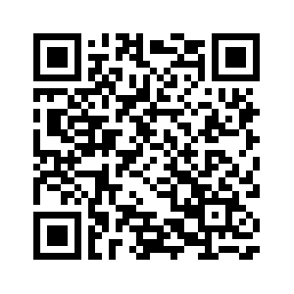
Understanding the Role of Wireless
Technology in Vocational Settings: A National Survey
Eliseo Jimenez PhD, BCBA-D, Josephine Mhende MPH, Claire Donehower PhD, BCBA-D,
Ramatu Muhammad MD, Allie Doulin, Sharish Hussain
INTRODUCTION
Employment is a major part of an adult’s identity and plays a significant role in creating a stable life environment (Chen et al., 2015)
Workplace support for adults with IDD can vary drastically due to the needs of the employee, but can include assistive technology (AT) (Butterworth et al., 2015)
Employers, individuals with IDD, and family members all `believe technology integration in workplace settings can increase skill acquisition and job security.
RESULTS
139 Total Respondents with the average age of 42
Figure 1. Respondent Identity
Figure 2. Respondent Gender
METHODS
National survey distributed via an online platform (Qualtrics). Target participants were: Rehabilitation service providers (Vocational counselors, transition coordinators, job coaches), individuals with IDD, and family members. Respondent minimum age was 18
53 total questions
15-30 minutes to complete
Questions specific to respondent demographics
Survey results will be used to influence local and state vocational policies and procedures in areas that would increase positive employee outcomes for individuals with IDD
Figure 3. Respondent Location
DISCUSSION
Although all respondents are in favor for the integration and use of technology in vocational settings, there is concern on the level of support needed.
Given the variety of technologies individuals with IDD currently use in home and community settings, future investigation is needed to match appropriate technologies to a given workplace with specific tasks.
Demographics
14 Questions
Person Living
With a Disability
13 Questions
Disability Service Provider
13 Questions
Family Member or
Caregiver
13 Questions
Scan the code with your mobile phone camera to access a plain text document.
REFERENCES
Butterworth, J., Hierseiner, D., Engler, J., Bershadsky, J., Bradley,V. (2015). National core indicators: Data on the current state of employment of adults with IDD and suggestions for policy development. Journal of Vocational Rehabilitation. 42. 209-220.
Chen, J., Leader, G., Sung., Leahy, M. (2015). Trends in employment for individuals with autism spectrum disorder: a review of the research literature. Journal of Autism and Developmental Disorders. 2:115-127.
CONTACT
If you are interested in learning more about this work, please contact Lead Author @ ejimenez7@gsu.edu
NOTE: The contents of this poster were developed under a grant from the National Institute on Disability, Independent Living, and Rehabilitation Research (NIDILRR grant number 90RE5025). NIDILRR is a Center within the Administration for Community Living (ACL), Department of Health and Human Services (HHS). The contents of this poster do not necessarily represent the policy of NIDILRR, ACL, HHS, and you should not assume endorsement by the Federal Government.

