Slide 1
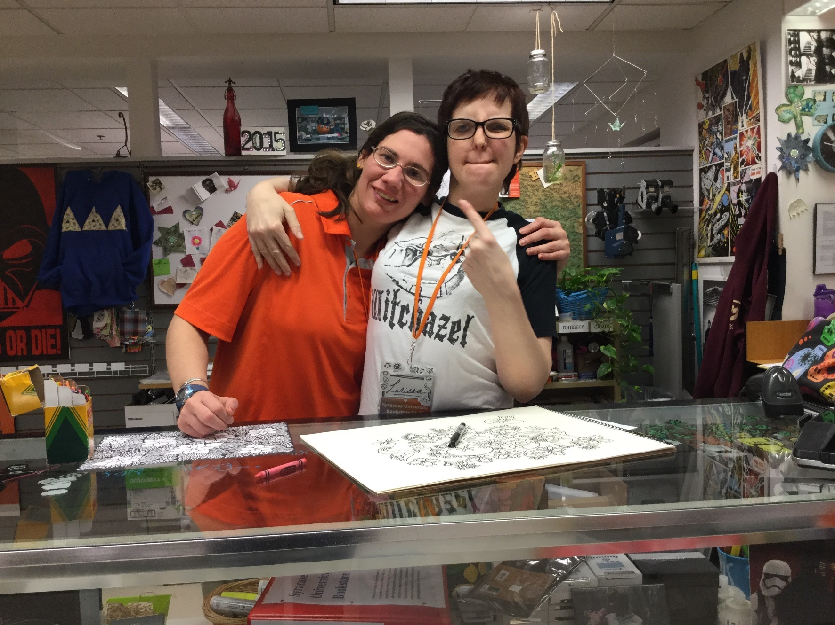
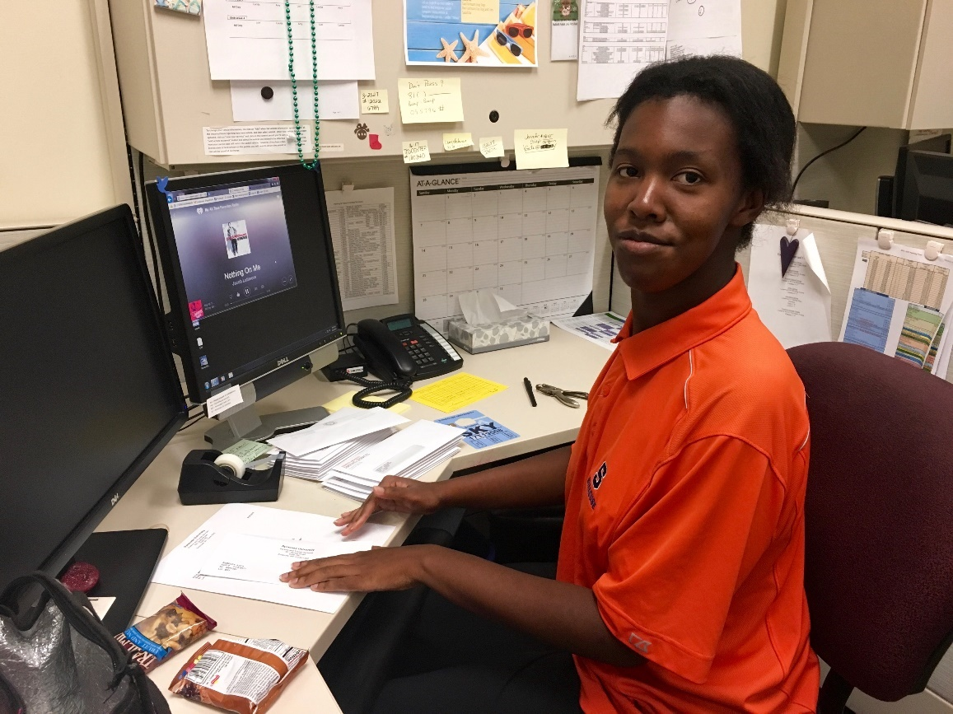
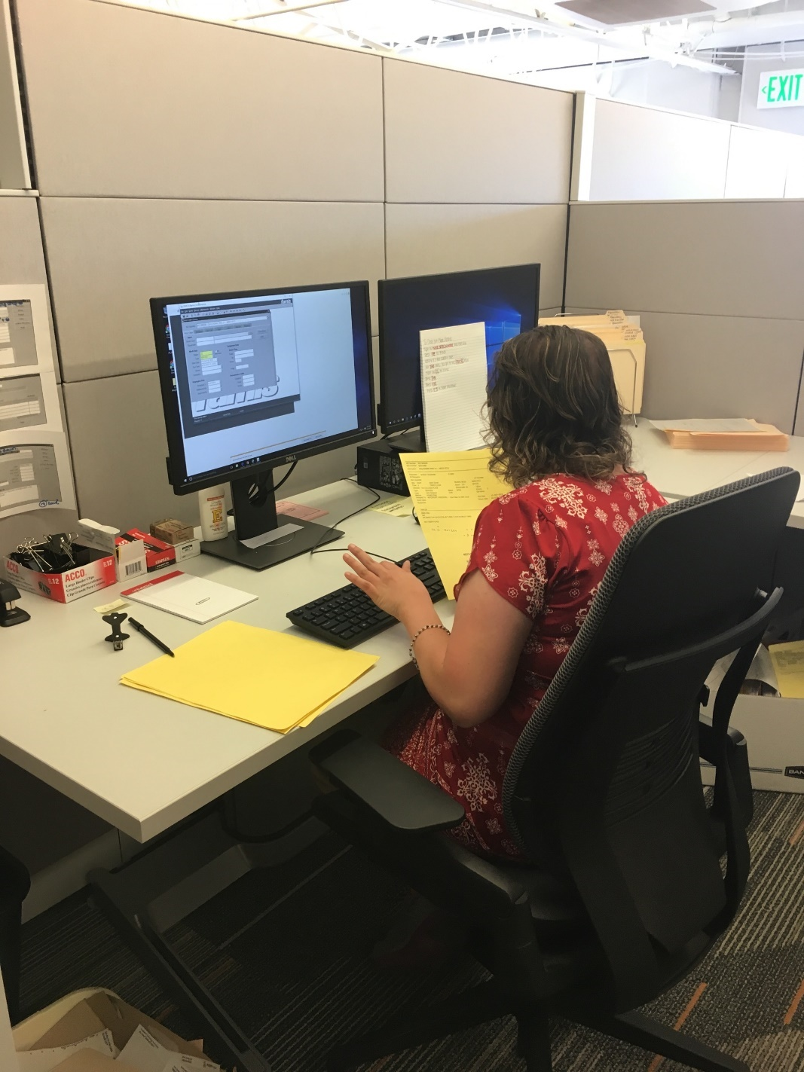
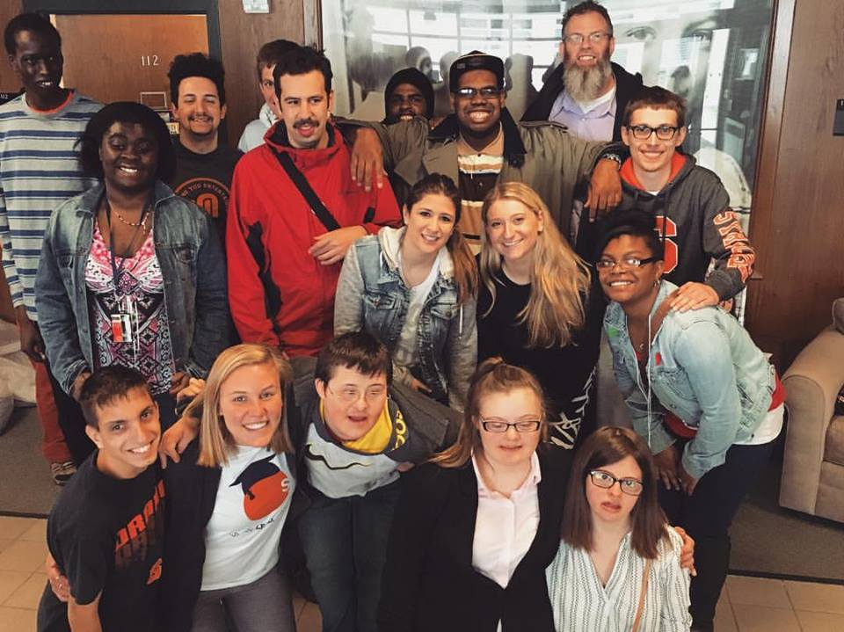
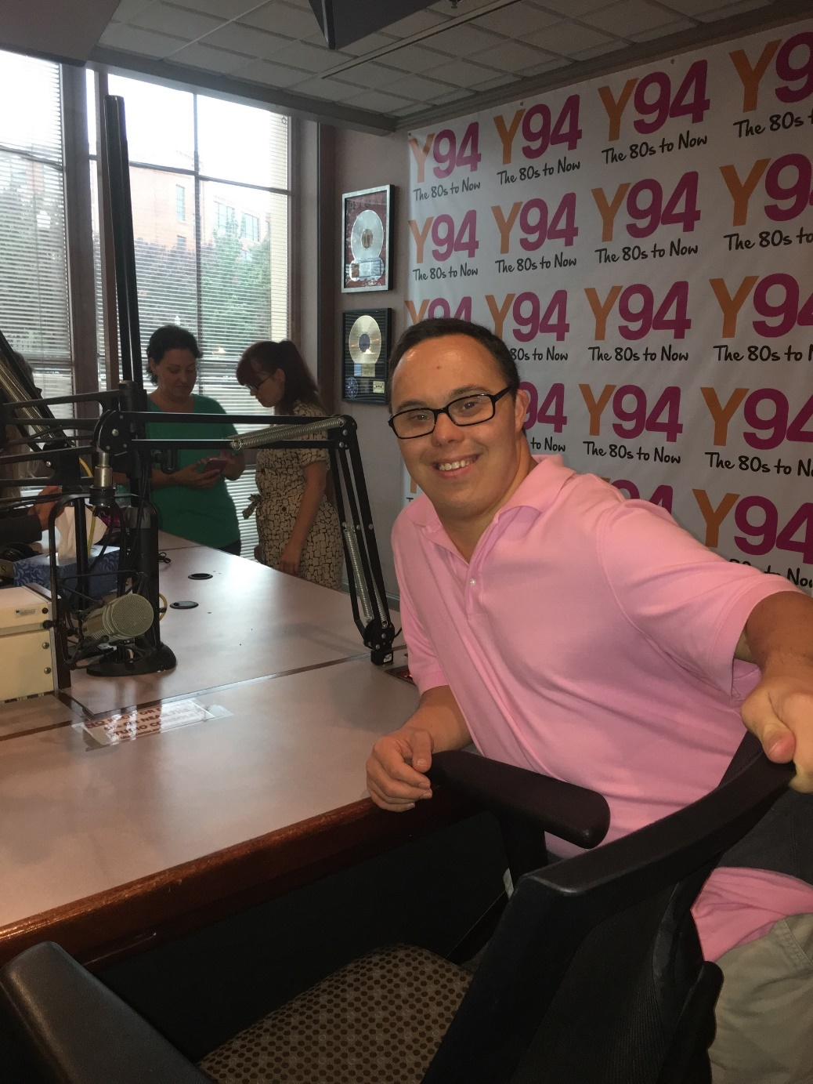
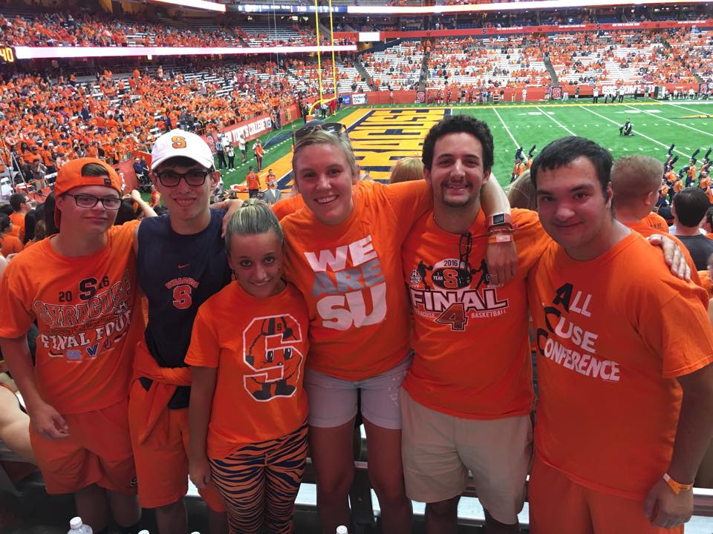
Your Inclusive College Experience is Over; Now What?
Project SEARCH at Syracuse University
Brianna M. Shults, Internship and Employment Coordinator
Lawrence B. Taishoff Center for Inclusive Higher Education at Syracuse University
InclusiveU/Project SEARCH Initiative
Overview
Model Components
Current Internships Available
Syracuse University is a certified host business site for this international model employment preparation program, developed at Cincinnati Children’s Hospital Medical Center, where students participate in three internships to explore a variety of career paths and to acquire transferable and marketable job skills.
Our goal is for all of our students to graduate from the program with competitive, inclusive employment.
Successful program outcomes for each Project SEARCH intern are defined as competitive employment in an integrated setting:
Non-seasonal employment, 16 hours per week or more, minimum wage (varies by state) or higher
Business led, allowing the students to learn relevant, marketable skills in their community through business immersion.
Collaboration of all partnering agencies to allow seamless transition of services.
Total immersion in the workplace each day along with on-site staff through a coordinator/teacher and job coaches.
Activities of the program are tied to federal IDEA (2004) Indicators
Graduation
Dropout Rates
Least Restrictive Environment
Parent Involvement
Transition Goals and Compliant IEP
Post School Outcomes
Graduates receive follow-along services after graduation to assist in maintaining their employment.
Schine Student Center Bookstore
FixIT Maintenance Department
Facilities Management
Mail Services Department
SUBCAT Recording Studios
Early Education and Child Care Center
Recreation Services
Materials Management
Parking and Transit Services
Food and Catering Services
Project SEARCH through InclusiveU
One of the most important outcomes of higher education for students with IDD is employment.
While Project SEARCH has partnered with more than twenty-five universities, Project SEARCH at SU is one of the first to offer both an inclusive higher education track and Project SEARCH on the same campus.
Our typically have completed InclusiveU at Syracuse University, and have graduated high school, or are 21 years or older. Students must have the goal of integrated competitive employment upon graduation from Project SEARCH. Internships are unpaid. Working with our local vocational rehabilitation, New York State Office for People with Developmental Disabilities (OPWDD), and a local agency support is provided on the site to allow students the assistance needed when learning a job.
A Day In the Life of an Intern
9:00 -9:45am Classroom Soft Skills Work
9:45-10:00am Travel to Internship Site
10:00am-2:00pm Internship
2:00-2:30 End of day wrap up
Interns at Syracuse University have the unique opportunity to engrain themselves in the diverse culture of the campus. Combined with our Peer2Peer initiative, students are able to not only contribute to campus life through meaningful work, but socially as well.
SU offers a large array of positions so individuals can pursue their interests and passions rather than simply accepting a position because it is available. The presence of interns with developmental disabilities in the work place changes the attitudes of supervisors and employees, and assists them in thinking more innovatively about roles individuals with disabilities can play in the success of an institution.
Our Partners
How are employment
outcomes improved?
Lawrence B. Taishoff Center for Inclusive Higher Education at Syracuse University
Syracuse University
Project SEARCH
New York State Adult Career and Continuing Education Services – Vocational Rehabilitation (ACESS-VR)
ARISE Inc.
New York State Office for People with Developmental Disabilities (OPWDD)
Interns are afforded the opportunity to enhance their skills in a safe environment. Through a business-led model we allow interns to be immersed in a culture and exposed to real work situations. Project SEARCH is based on the individuals needs, taking into account strengths, skills, talents, and preferences. Expectations on interns are raised, and as expectations increase, so does the interns’ performance.
Logistical difficulties individuals may face when seeking employment are addressed:
Transportation
Medicaid, SSI/SSDI Myths and concerns
Extended time for self-care tasks
Attitudes of employers
Throughout the year students learn to problem solve these various issues by learning how to take public transportation independently, working on soft skills during classroom time and attending seminars. Seminars cover topics such as self- representation, circles of support, person-centered planning, positive personal relationship choices, media and technology, employment skills, and navigating the campus.
Through a business-minded setting, students are able to learn and build on their work skill sets in order to reach their employment goals. Equipping interns with soft skills and specific work skill sets helps them to grow in maturity, increase independence, and achieve competitive employment.

