Slide 1
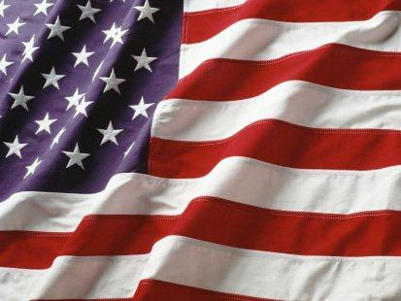
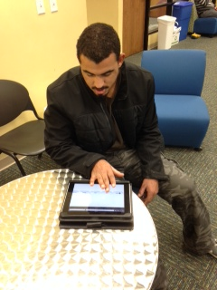
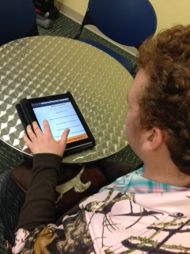
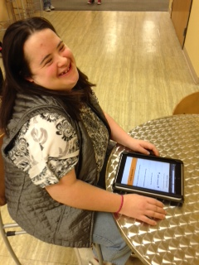
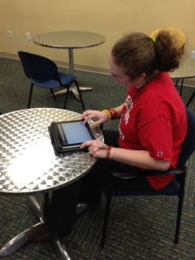
Universal Voting Systems:
Effectiveness of the PRIME III for Voters with a Developmental Disability
Lindsey Bucher, B.A., Jane Gerhardt, J.D., Emily Schreiber, M.A.
Sandra Grether, Ph.D., Lizanne Mulligan, Ph.D., Brady Sellet
Leadership Education in Neurodevelopmental and related Disabilities (LEND) Program
The Division of Developmental and Behavioral Pediatrics , Cincinnati Children's Hospital Medical Center
The University of Cincinnati University Center for Excellence in Developmental Disabilities
Background
Research has found that physical barriers, inaccessibility of voting systems, and difficult interactions with poll workers were common factors for lower voter turnout for those with a disability (Schur, Shields, Kruse & Schriner, 2002).
Understanding how to use voting equipment was one of the most commonly reported voting problems for those with a disability (Schur, Adya, & Kruse, 2013). Previous voting solutions, such as e-voting machines, were a reported significant improvement over manual voting for those with a disability. However, specific features of each machine (e.g., display of text, design of controls) continue to present barriers to voting for those with a disability (Baker, Roy & Moon, 2005).
In 2005, the PRIME III electronic voting system was created in response to previous difficulties with voting systems. This multimodal program provides a private, secure, and independent experience that permits users to vote using touch, breath, or voice regardless of impairment (Gilbert et al., 2008).
Method
Participants of the study were 19 Starfire U students with a developmental disability, aged 22-30, and 14 LEND trainees without a developmental disability, aged 24-50. There was no inclusion or exclusion criteria for this study. However, one participant was excluded from data analysis due to her inability to read.
The study was conducted using the Prime III voting system, accessed through Safari, on an iPad tablet device. This software was developed by Dr. Juan Gilbert of Clemson University. Ballot items asked opinions on popular topics and were written on a fourth grade reading level in order to assess the voter’s ability to use the technology, rather than their understanding of the ballot question.
Both groups were provided with individual verbal instructions on how to vote on the device, shown a sample ballot, and then given the iPad to vote independently.
To determine ease of use, researchers recorded the time it took participants to complete the ballot, conducted behavioral observations, and asked follow-up questions about satisfaction with the voting program. For the purpose of this study, accuracy was defined as the ability to vote as intended. This was assessed by the researchers comparing the individual's verbally expressed vote on each ballot question to the system’s submission confirmation page.
Results
Independent samples t-tests were conducted to examine accuracy and ease of use between the two samples. There was no statistically significant difference in accuracy between the two groups. However, there was a statistically significant difference in ease of use, as measured by completion time (t= -3.702, p =.001). Those with a developmental disability took more time to complete the ballot.
Qualitatively, participants of both samples reported satisfaction with the program and the desire to use it in future voting experiences. Analysis of behavioral observations indicated some participants with a developmental disability had moderate difficulty with technological aspects of the tablet device, which may have increased completion time. None the less, all of these individuals were able to overcome the difficulties and complete the ballot.
Discussion
This study indicates that individuals with a developmental disability are able to successfully vote as intended in an independent and private manner when using the Prime III voting system. After brief instructions with a practice ballot, our sample of individuals with a developmental disability was able to vote with similar accuracy to those without a developmental disability. However, participants with a developmental disability took significantly longer to vote than those without.
Due to technological and financial limitations, this study was conducted using iPad tablets, which was not the original design platform for the voting system. Voting was conducted using touch responses. However, other multimodal features, such as voice or switch, were inoperable. Although participants had the ability to vote by touch, future research should investigate individuals with a developmental disability voting with Prime III using all of its multimodal features.
The majority of participants with and without a developmental disability had previous technological experience. The authors of this study thus did not provide an introduction to personal electronic devices. Future research should investigate if adults with a developmental disability, but without education in the use of or experience with these types of devices, can successfully vote.
Sample | Number of Participants | Average Time (seconds) | Average Accuracy (percent)
Individuals without a DD | 13 | 26.23 | 100
Individuals with a DD | 18 | 68.72 | 92
Objective
The purpose of this study was to examine the ease of use and accuracy of Prime III, technology designed specifically to enable those with a disability to vote.
Acknowledgements
Special appreciation for the staff and students at Starfire, Cincinnati, Ohio; Dr. Juan Gilbert, Clemson University; Essie Pederson, Co-Director NTAC for Voting and Cognitive Access, Self Advocates Becoming Empowered.
References
Baker, P. M., Roy, R. G. B., & Moon, N. W. (2005, November). Getting out the vote: Assessing Technological, Social and Process Barriers to (e) Voting for people with Disabilities. In The Twenty-Seventh Annual APPAM Research Conference, Washington, DC.
Gilbert, J. E., MacDonald, J., Hill, R., Sanders, D. T., Mkpong-Ruffin, I., Cross, I. I., & Rogers, G. (2008). Prime III: Defense-in-depth approach to electronic voting. Journal of Information Privacy & Security, 4(3).
Schur, L., Adya, M., & Kruse, D. (2013, June). Disability, Voter Turnout, and Voting Difficulties in the 2012 Elections. In U.S. Election Assistance Commission and Research Alliance for Accessible Voting.
Starfire U students participating in Prime III voting activity.

