Slide 1
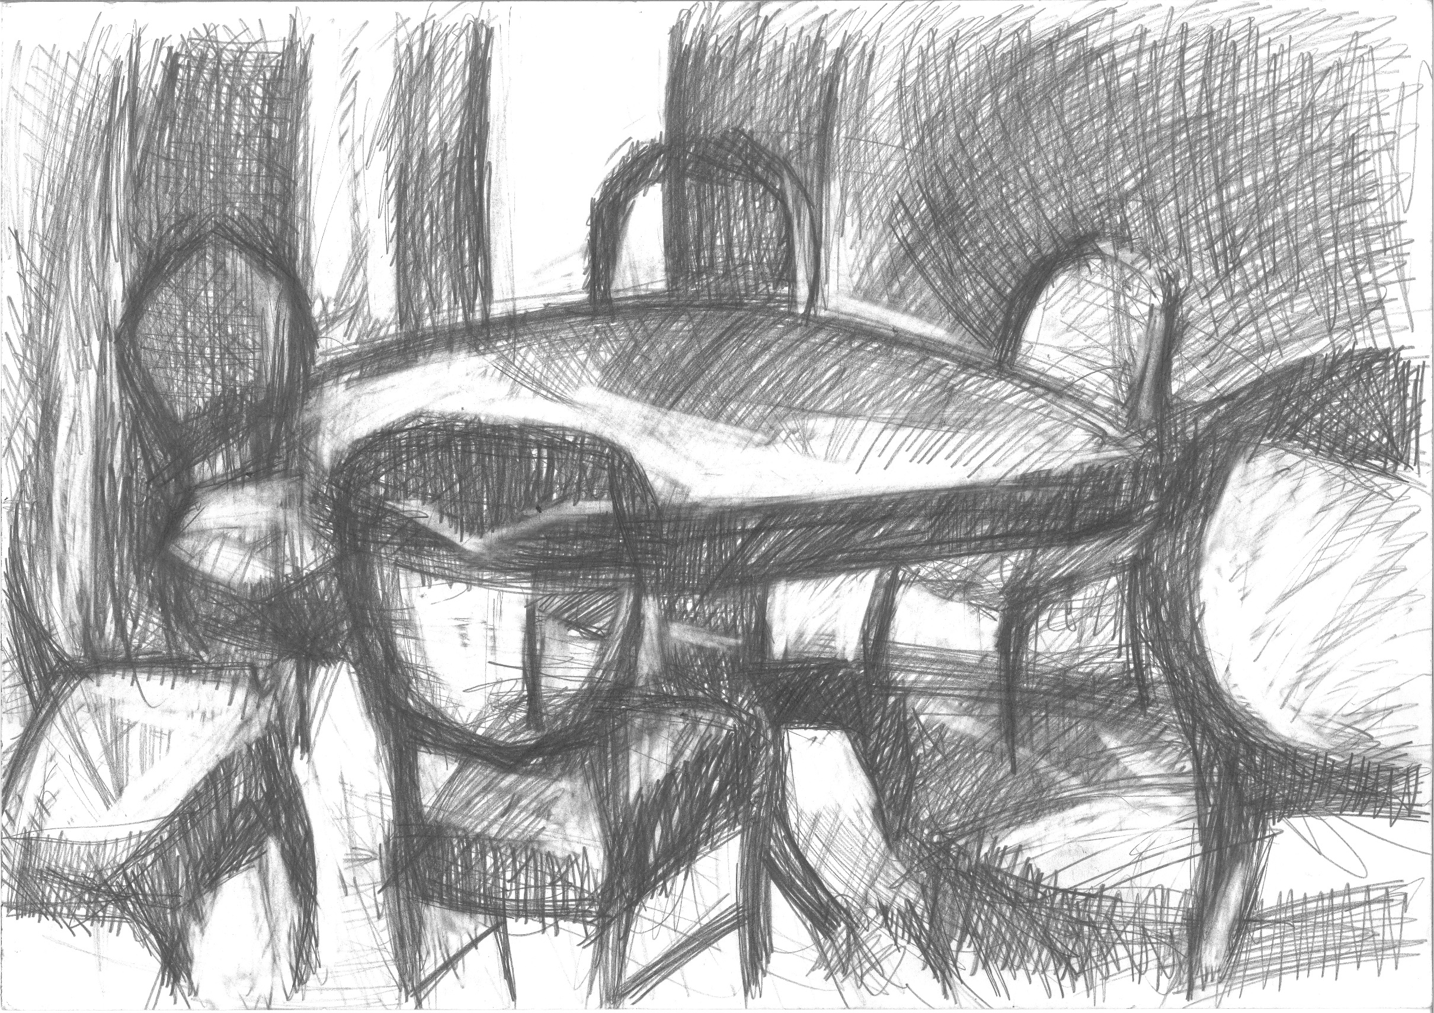
Promoting Feeding Interventions to Support Healthy and Meaningful Participation
Jan T. Marson, OTD, OTR/L, BCP, Linda O’Neil, MS, Erika Ryst, MD,
Barbara Scott, MPH, RD, LD, Natalie Klekovic, Lisa Lottritz, RN, BSN,
Molly Michelman, MS, RDN, LD, CLC, and Jessica R. Stewart, MS, CCC-SLP
NvLEND
University of Nevada, Reno
Project Overview
Effective Interventions to Help Families Heal (Adapted from Heweston, 2009)
Three broad-based themes were identified for interventions (continued):
A transdisciplinary research review was conducted during September and October of 2013. The purpose was to explore evidenced-based interventions and strategies shown to promote positive outcomes for both children with autism and neurodevelopmental conditions with feeding challenges in an inclusive, family-centered manner. Search terms were developed by the leadership group and the following databases were explored: Medline, CINAHL, PsycINFO, PubMed, Cochrane and Campbell Collaborations, ERIC, and Academic Search Premier, as well as hand searches of bibliographies. The reviews included peer-reviewed articles published in the English language going back twenty years to 1993. An evidence table has been created to organize interventions and strategies related to our focused question.
Recommendations to Encourage Positive Eating Habits
Establish routine meal and snack time; the feeding environment is to be structured
Minimize environmental distractions
Keep mealtime calm and strive for an enjoyable experience
Caregivers should sit with child and eat the same foods
Offer child what everyone else is eating but also provide one preferred food
Refrain from pleading/threatening to persuade child to eat
Respect child’s ability to eat when they are hungry and stop when they are full
A Journey of Loss and Disempowerment:
Feeding as a chore instead time for bonding
Questioning
Losing the mother dream
Changes in family interactions
Changes in lifestyle
Changes to employment status
Changes in future plans
Caregiver to onlooker
Disempowered by professional interactions
Unanswered questions/unmet needs
Consider the Division of Responsibility in Feeding by Ellyn Satter, MS, RD, LCSW, BCD:
Conceptualizing The Family Table From Multiple Perspectives
Parents’ Feeding Jobs: Choose and prepare the food, provide regular meals and snacks, make eating times pleasant, show children what they have to learn, be considerate of children’s food inexperience without catering to likes and dislikes, and do not let children have food or drinks (except for water) except for meal and snack times
Children’s Eating Jobs: Grow up to have body that is right for them, eat the amount they need from what is offered, learn to eat the food their family eats, learn to eat in a socially acceptable manner, eat when they are hungry and stop when they’re full
Focused Question: What is the evidence to support transdisciplinary interventions and strategies to promote positive outcomes for children with autism and neurodevelopmental conditions with feeding challenges in an inclusive, family-centered manner?
Physiological Interventions: Interventions that concentrate on improving children’s biological development, including physical and sensory functions to support infant feeding.
•Preparatory Behaviors• Feeding skills• Environmental Supports•
Resources provided to meet treatment implications to increase sensitivity in professionals:
Ensure parents feel supported
Provide reassurance to parents
Emphasize progress to parents
Help parents develop support systems
Look for caregiver mental health concerns
Help parents provide children with adequate and appropriate nutrition
through information resources (Franklin and Roder, 2003)
Healthcare professionals should guard against assumptions of parental needs and should actively gain insight into a mother’s experiences by creating an environment in which mothers are afforded the opportunity to discuss their practical and emotional needs.
Infants Experiencing Feeding Difficulties
Length of nipple and pacifiers is important
Size and weight of bottle regulate flow
Specialty bottles are indicated for particular feeding concerns
Infants can use breast/bottle and pacifiers without causing oral aversion
Appropriate size feeding utensils and consistency of usage is essential
Experiences and tools that are matched to life course
Feeding device use should be limited and temporary
Use cue-based feeding approach
Sensory Issues and Strategies for Feeding
Be mindful and attentive to the sensory aspects of environment
Begin with supportive positioning and appropriate seating system
Respect child’s rights to act independently and make choices
Consider unique individual sensory profile
Enhance oral experience with flavor and scent
Sweet facilitates tongue protrusion
Sour/bitter tastes facilitate tongue retraction
Limit face wiping during feeding
Manage food stuffing
Judiciously use vibration to desensitize or as medium to deliver food
Utilize sense of smell for increased attention and arousal
Scents activate memory systems
Cultivate awareness of outside acoustics
Utilize the magic of music and how it organizes body rhythm
Ponder visual appeal
Contemplate visual arrangements
Goals for effective feeding interventions should be: (1) safe, (2) functional, (3) nurturing, as well as (4) individually and developmentally appropriate.
Getting Through the Brokenness:
• Creating a new dream
• Celebrating the positives
• Finding information and support
• Acquiring skills
• Challenging and advocating
• Facilitating home-based caregiving
• Feeling heard
• Feeling hopeful
• Ability to thrive in the system of care
Three broad-based themes were identified for interventions:
Behavioral Interventions: Evidence supports improvement in the acceptance of a variety of foods; mealtime behaviors; weight gain and increasing caloric intake; and decreasing caretakers’ stress.
Cognitive Behavioral Strategies
Reinforcement
Redirection
Extinction
Social modeling
Empowering through choice
Disorganized Chairs, Courtesy of Sarah Lightman
www.Sarahlightman.com
Help Children and Families Make Friends with Food
Selecting, cooking, and preparing food
Exploring sensory properties of food
Using food and art projects
Gardening
Social stories
Feeding routines in symbolic play; such as picnics and tea parties
Motor Learning Concepts (Sheppard, 2008)
Attention and motivation
Variability in developmental sequences
Specificity of learning
Implicit learning
Rehearsal strategies
Maximizing opportunity for practice
Blocked and random practice
Distribution of practice
Extrinsic feedback
Transfer of learning
Parent-Directed and Educational Interventions: Evidence supports that these interventions are effective in improving physical growth, development, increasing feeding competence of children and their caretakers, and in improving the parent-child relationship in a variety of populations.
Parenting practices associated with preventing obesity in pre-school children with disabilities are as follows:
Providing the child access to healthy foods
Having a matter-of-fact attitude /approach (calm; not pressuring)
Modeling healthy eating
Modeling physical activity to include caregiver participation
Improving caretaker’s nutritional knowledge
Promoting an authoritative feeding style with reasonable expectations and consistency (McGillivary, 2013)
References
Future directions for translational research may include the development of best practice feeding guidelines for families and children with autism and neurodevelopmental disabilities that are culturally appropriate and that can be utilized in their natural environments.
Hewetson, R. & Singh, S. (2009). The lived experience of mothers of children with chronic feeding and/or swallowing difficulties. Dysphagia, 24, 322-332.
Howe, T.H. & Wang, T.N. (2013). Systematic review of interventions used in or relevant to occupational therapy for children with feeding difficulties ages birth-5years. American Journal of Occupational Therapy, 67, 405‐412.
McGillivray, J., McVilly, K., Skouteris, H., & Boganin, C. (2013). Parental factors associated with obesity in children with disabilities: A systematic review. Obesity Reviews, 14, 541‐554.
Satter E.M. (1990). The feeding relationship: Problems and interventions. Journal of Pediatrics, 117, 181-189.
Sheppard, J. J. (2008). Using motor learning approaches for treating swallowing and feeding disorders: A review. Language Speech Hearing Services in the Schools, 39, 227‐236.

