Slide 1
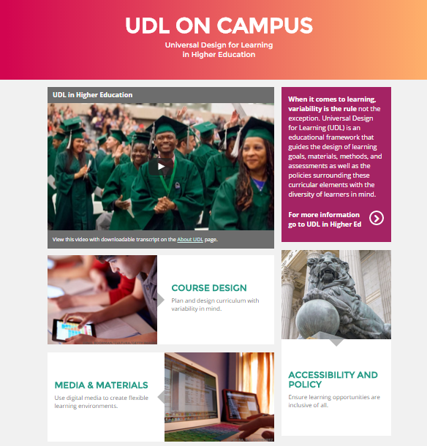
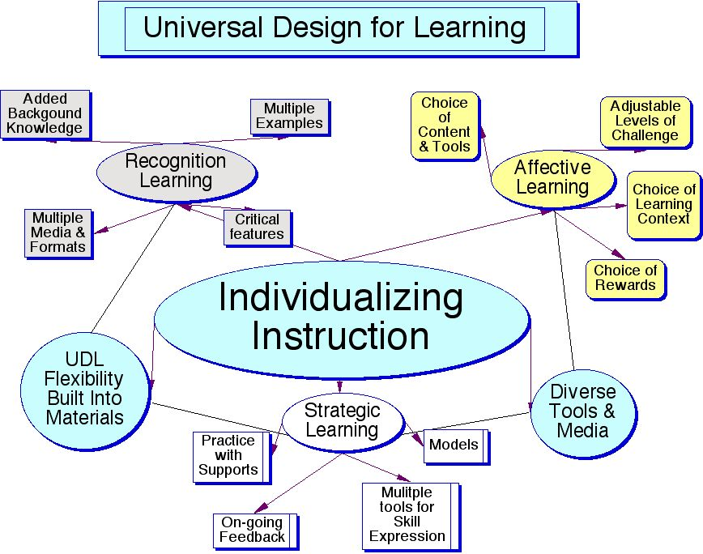
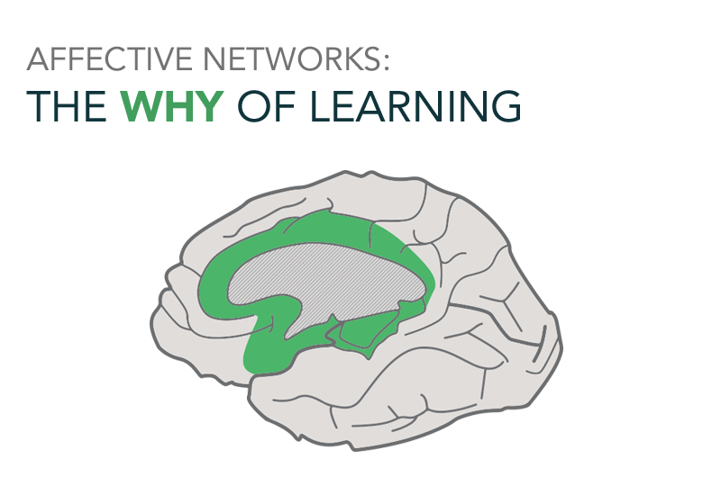
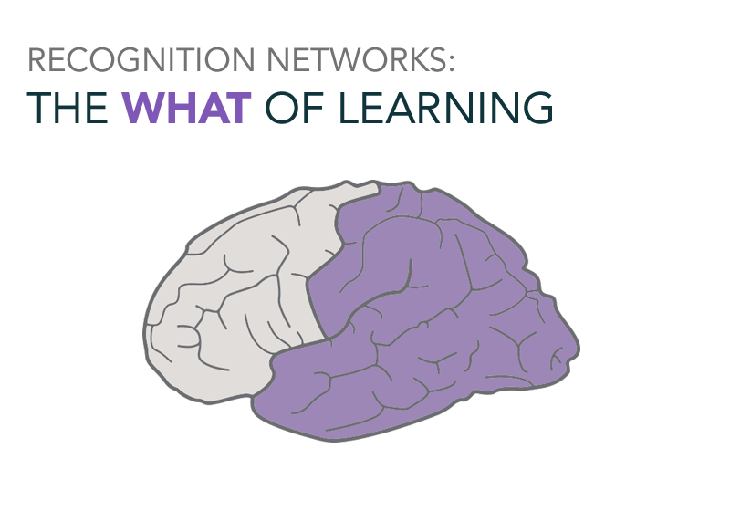
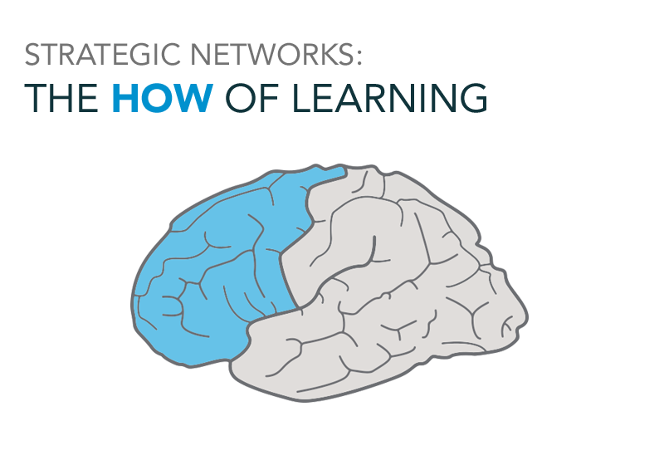
Towson University’s Universal Design for Learning (UDL) Faculty Development Initiatives
David Wizer, Ph., D.• College of Ed., Dept. Ed. Tech. & Literacy
Jane Neapolitan, Ed.D. • Office of Academic Innovation
What is UDL?
UDL at Towson
Outputs
Next Steps
Universal Design for Learning (UDL)
Designed to develop educational environments that give all individuals an equal opportunity to learn (CAST, 2012).
Scientifically validated framework (HEOA, 2008) for supporting all learners through flexible curriculum that utilizes multiple means of
engagement,
action and expression,
representation.
Encourages faculty to add instructional options to challenge advanced learners & supports for students at the margins.
Enables a cultural shift toward student-centered practices and inclusiveness in teaching.
See: http://udlexchange.cast.org/
Course Example Upgrade ISTC 301 Integrating Instructional Technology
Required 3 credit course for ed. majors
Course taught in computing lab often as a hybrid employing Blackboard
Course has a key assignment- Practical teaching experience [PTE] which is where we added UDL elements & major course
Based on Course data we made this significant and successful change
Course outcome data revealed positive integration of UDL ideas in student work
UDL Professional Development Network (UDL-PDN) 2013-2016.
85 faculty and staff participate in professional learning communities that include
face-to-face and online professional development,
just in time support by a UDL facilitator,
professional learning opportunities,
tool and resource sharing.
Faculty coaches with advanced UDL training provide peer-to-peer support
Wide array of updates, teaching materials
revised syllabi, final projects,
learning assessments,
digital learning objects.
College of Education & Dept. Upgrades
Numerous courses- intro thru graduate
Programs in an array of areas
Cross Campus Implementation
Gen Ed Course Redesign
Peer Consultations & Cohorts
Revision of Appointment, Reappointment, & Tenure policy that values & rewards the work of UDL.
UDL Exchange
50 University Faculty UDL-PDN Members
6 Colleges
1 University Library
14 Disciplines
From Art...
to Business...
85 UDL Learning Objects
50 UDL Resources
25 UDL Lessons
10 UDL Collections
to Education...
to Literature...
to Science…
Learn More
Extra info do not print
Web Resources
National Center on UDL http://www.udlcenter.org/
CAST is the organization behind UDL http://www.cast.org/
Collection of UDL resources from CAST http://udlexchange.cast.org/home
Multimedia Resource Organization https://www.merlot.org
UDL on Campus http://udloncampus.cast.org/
Student examples: http://tiaratyer.weebly.com/projects.html http://deanna-istc.weebly.com http://tsmith67.weebly.com/pte.html http://jmille113.weebly.com/
Course Focus

